Slide 1
Fundamentals of Information Technology and Networking Portfolio
Blanche Perez
DeVry University
NETW191

Slide 2
This Portfolio Contains:
Introduction
Modules
What was learned in each module
Conclusion

Slide 3
Introduction: What is Information Technology and Networking?
The development, maintenance, or usage of systems – particularly computer systems, software, and networks – for storing, retrieving, and transmitting information is referred to as information technology. Computer networking is the process of electrically connecting two or more computing devices in order to share data via data links.

Slide 4
Module 2: IPv4 and IPv6 Addressing
In this module, we operate a network, utilizing both IPv4 and IPv6 addressing schemes. The travel router will be assigned both an IPv4 and an IPv6 address.

Slide 5

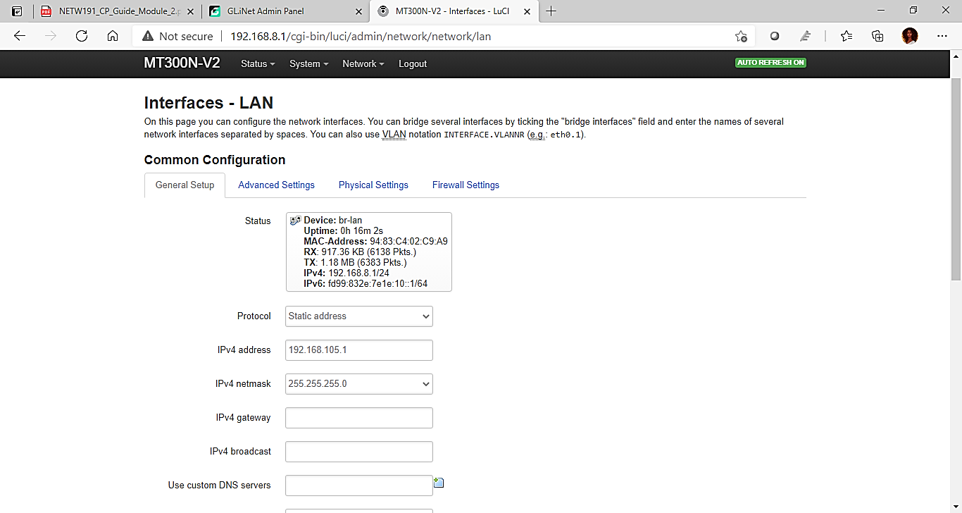

IPv4 Address Assignment of the Travel Router
This screenshot includes the following:
IPv4 address
IPv4 netmask

Slide 6

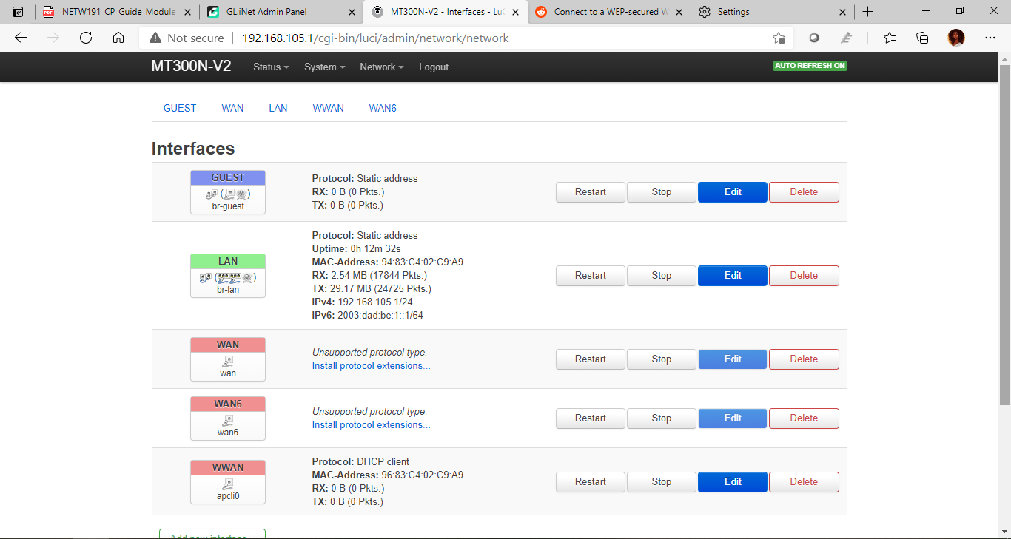
IPv6 Address Assignment of the Travel Router
This screenshot includes:
IPv6 address
IPv6 prefix

Slide 7
What was learned in this module…
Configuring the settings within the travel router.
Identifying IP addresses and what they are utilized for.
Learning about the interfaces and how they can be used.

Slide 8
Module 3: Virtual Machine (VM) Dynamic IP Assignment
In this module, we had to configure the VMware environment that supports bridging so that the Ubuntu VM could connect to the LAN interface of the travel router via the host computer's NIC. The host computer and (guest) Ubuntu VM will then get IP settings from the travel router dynamically.

Slide 9
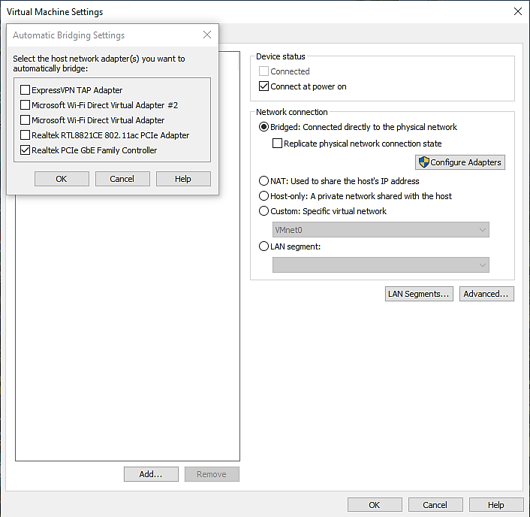
VM Bridging Settings
This screenshot shows the host computer network adaptor we want to automatically bridge.

Slide 10
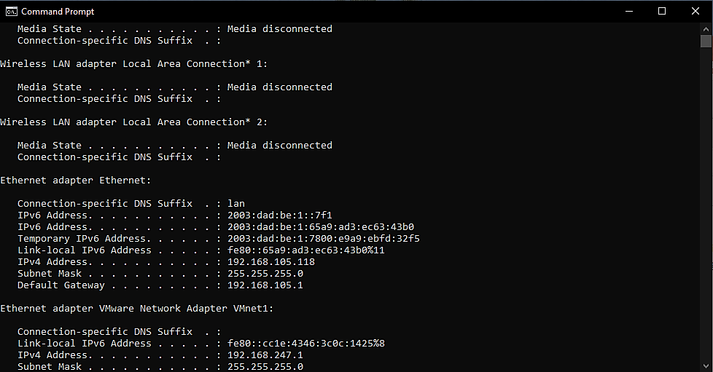
Host Computer Dynamic IP Assignment
This screenshot shows correct IPv4 and IPv6 addresses of the Windows host computer.
Note: This information has been updated.

Slide 11
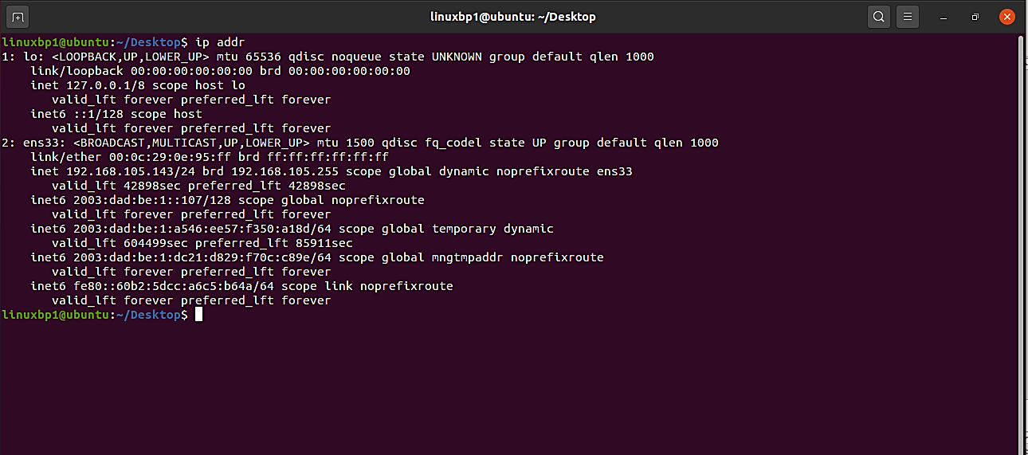
Ubuntu VM Dynamic IP Assignment
This screenshot shows correct IPv4 and IPv6 addresses of the Ubuntu VM.
Note: The information has been updated.

Slide 12
What was learned in this module…
Error configuration and problem solving.
Investigating how IP addresses and default gateways are used.
Utilizing the host’s computer and a virtual machine to access command prompts to see internet connections.

Slide 13
Module 4: Connectivity Test and Visio Network Diagram
In this module, the objectives were to test the connectivity between the host computer, the Ubuntu VM, and the travel router. Then, using Microsoft Visio, draw a network diagram depicting the connections of the host computer, Ubuntu VM, and travel router.

Slide 14
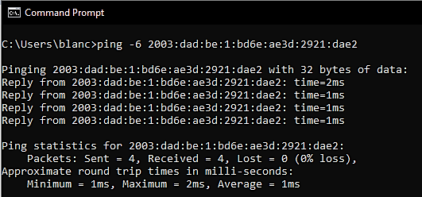
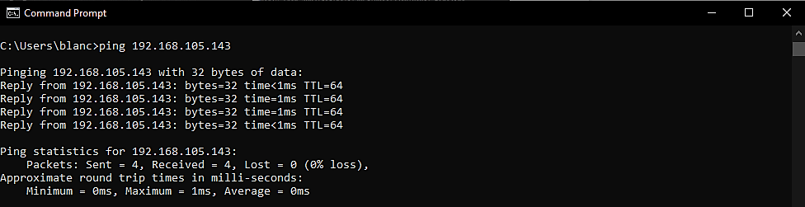
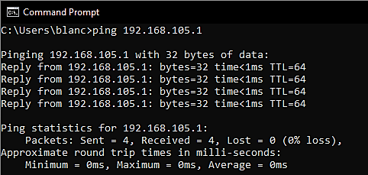
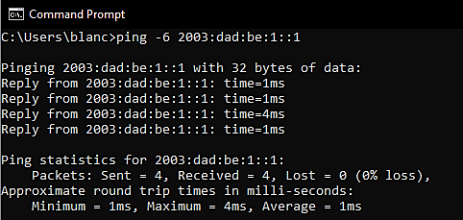
Connectivity Test From the Host Computer to all Other Devices
These screenshots show four successful ping tests.
Note: This information has been updated.

Slide 15
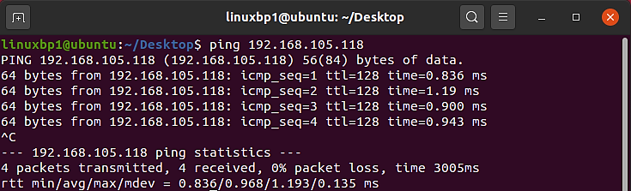
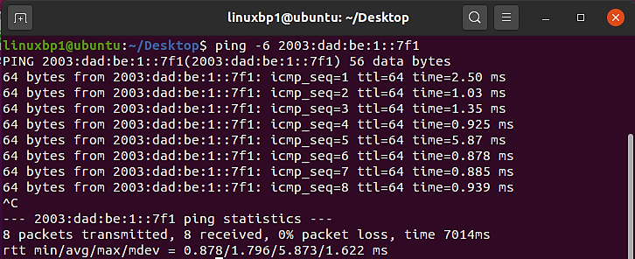
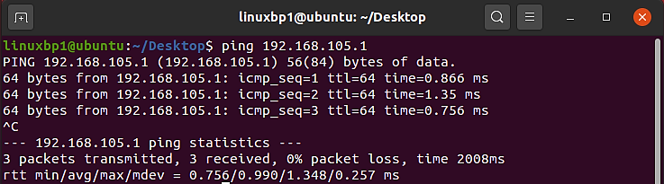
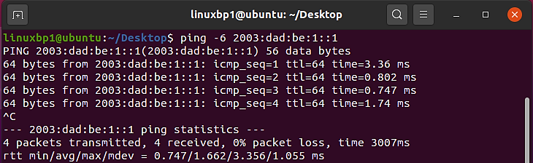
Connectivity Test From the Ubuntu VM to all Other Devices
These screenshots should show four successful ping tests.
Note: This information has been updated.

Slide 16
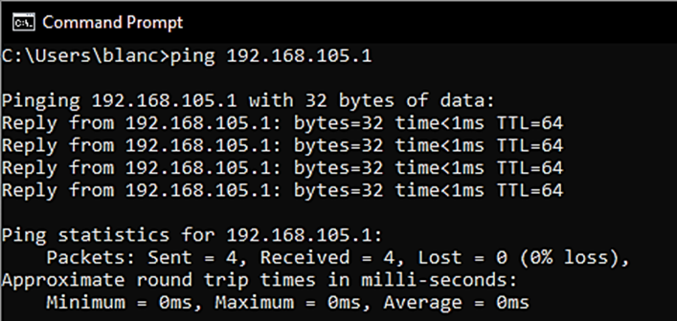
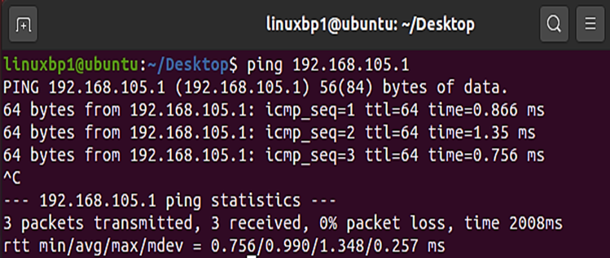
Microsoft Visio Network Diagram
Windows 10 Host
Ubuntu VM
Virtual Switch
195.168.105.1
(reachable)
This diagram depicts the interconnection of the host computer, Ubuntu VM, and travel router.
Travel Router
Note: This information has been updated.

Slide 17
What was learned in this module…
Discovering IP configuration and solving errors.
Creating a diagram displaying the different connections between the host computer and the virtual machine.
Connecting to a travel router and accessing a network.

Slide 18
Module 5: IP Subnetting and Loopback Interfaces
In this module, we begin with a class C network and divide its IP address block into smaller pieces (i.e., subnets). Following that, we have to setup two loopback interfaces on the trip router with IP addresses from newly created subnets to replicate extra LAN segments on an enterprise network.

Slide 19
Subnetting Table
 | Subnet Notation (x.x.x.x/x) | Network Address (1st IP address) | First usable host address (2nd IP address) | Last useable host address (2nd from the last IP address) | Broadcast Address (the last IP address)
The first subnet | 225.225.255.252/30 | 192.168.5.0 | 192.168.5.1 | 192.168.5.2 | 192.168.5.3
The second subnet | 225.225.255.252/30 | 192.168.5.32 | 192.168.5.33 | 192.168.5.34 | 192.168.5.35
This table includes two /30 subnets, including the network address, first usable host address, last usable host address, and broadcast address for each subnet.

Slide 20
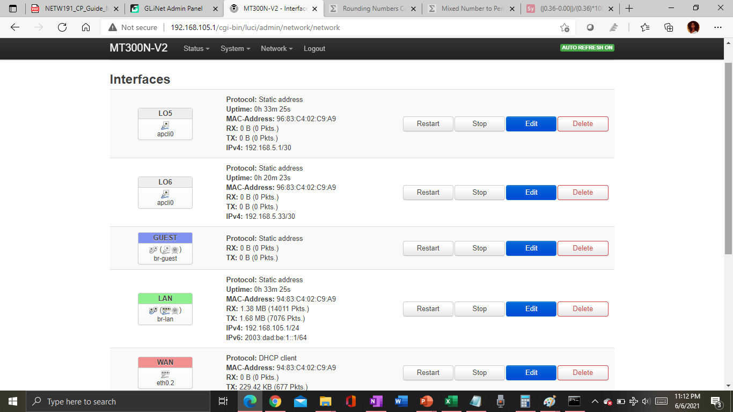
Loopback Interfaces
This screenshot shows both Lo5 and Lo6 loopback interfaces and their correct IPv4 addresses.

Slide 21
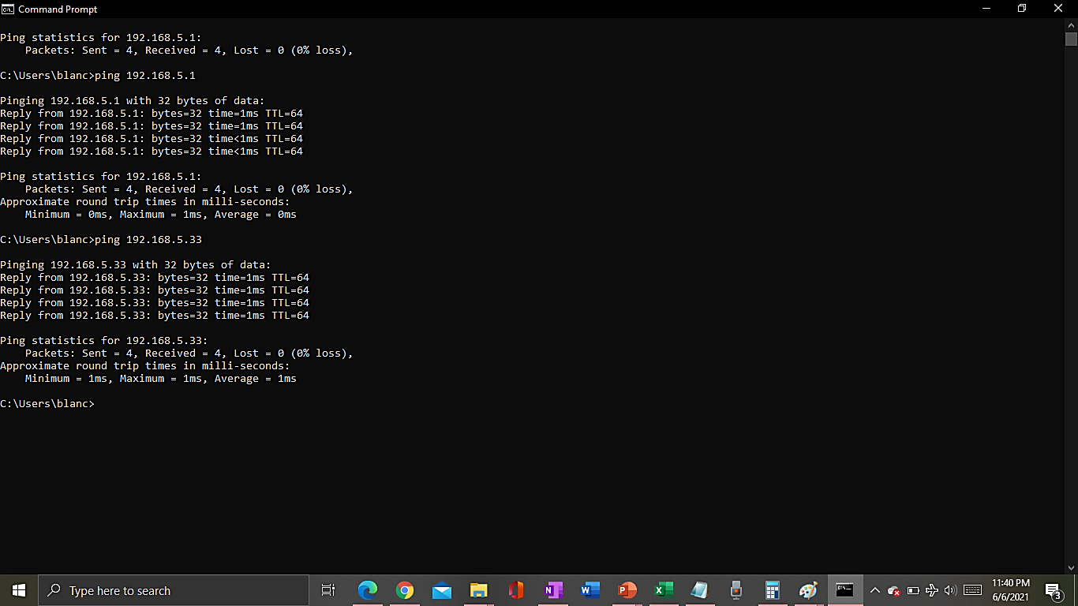
Ping Tests
IP: 192.168.5.1
This screenshot shows two successful ping tests from the host computer to the Lo5 and Lo6 interfaces.
IP: 192.168.5.33

Slide 22
What was learned in this module…
Learning to create the correct subnets.
Creating new interfaces for loopbacks and IP addresses.

Slide 23
Module 6: WLAN Implementation
In this module, we configured the service set identifier (SSID) of a basic wireless local area network (WLAN) and check the IP address of a wireless client device.

Slide 24
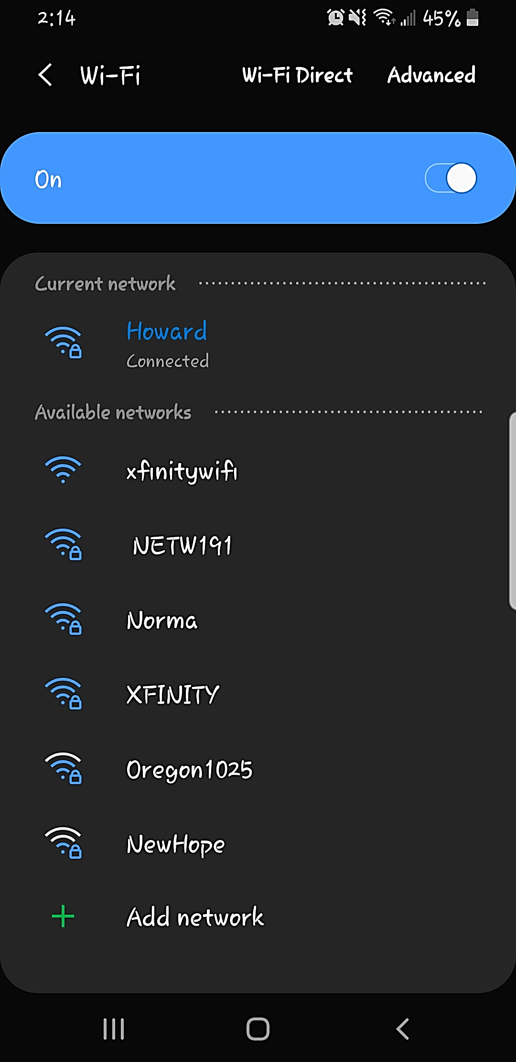
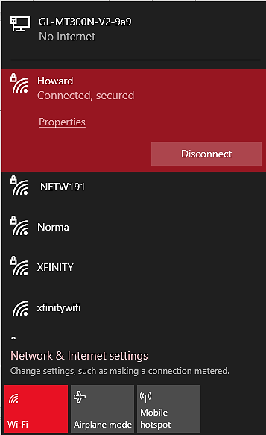
Smartphone
PC
List of SSID Names
These screenshots show the newly configured NETW191 SSID.

Slide 25
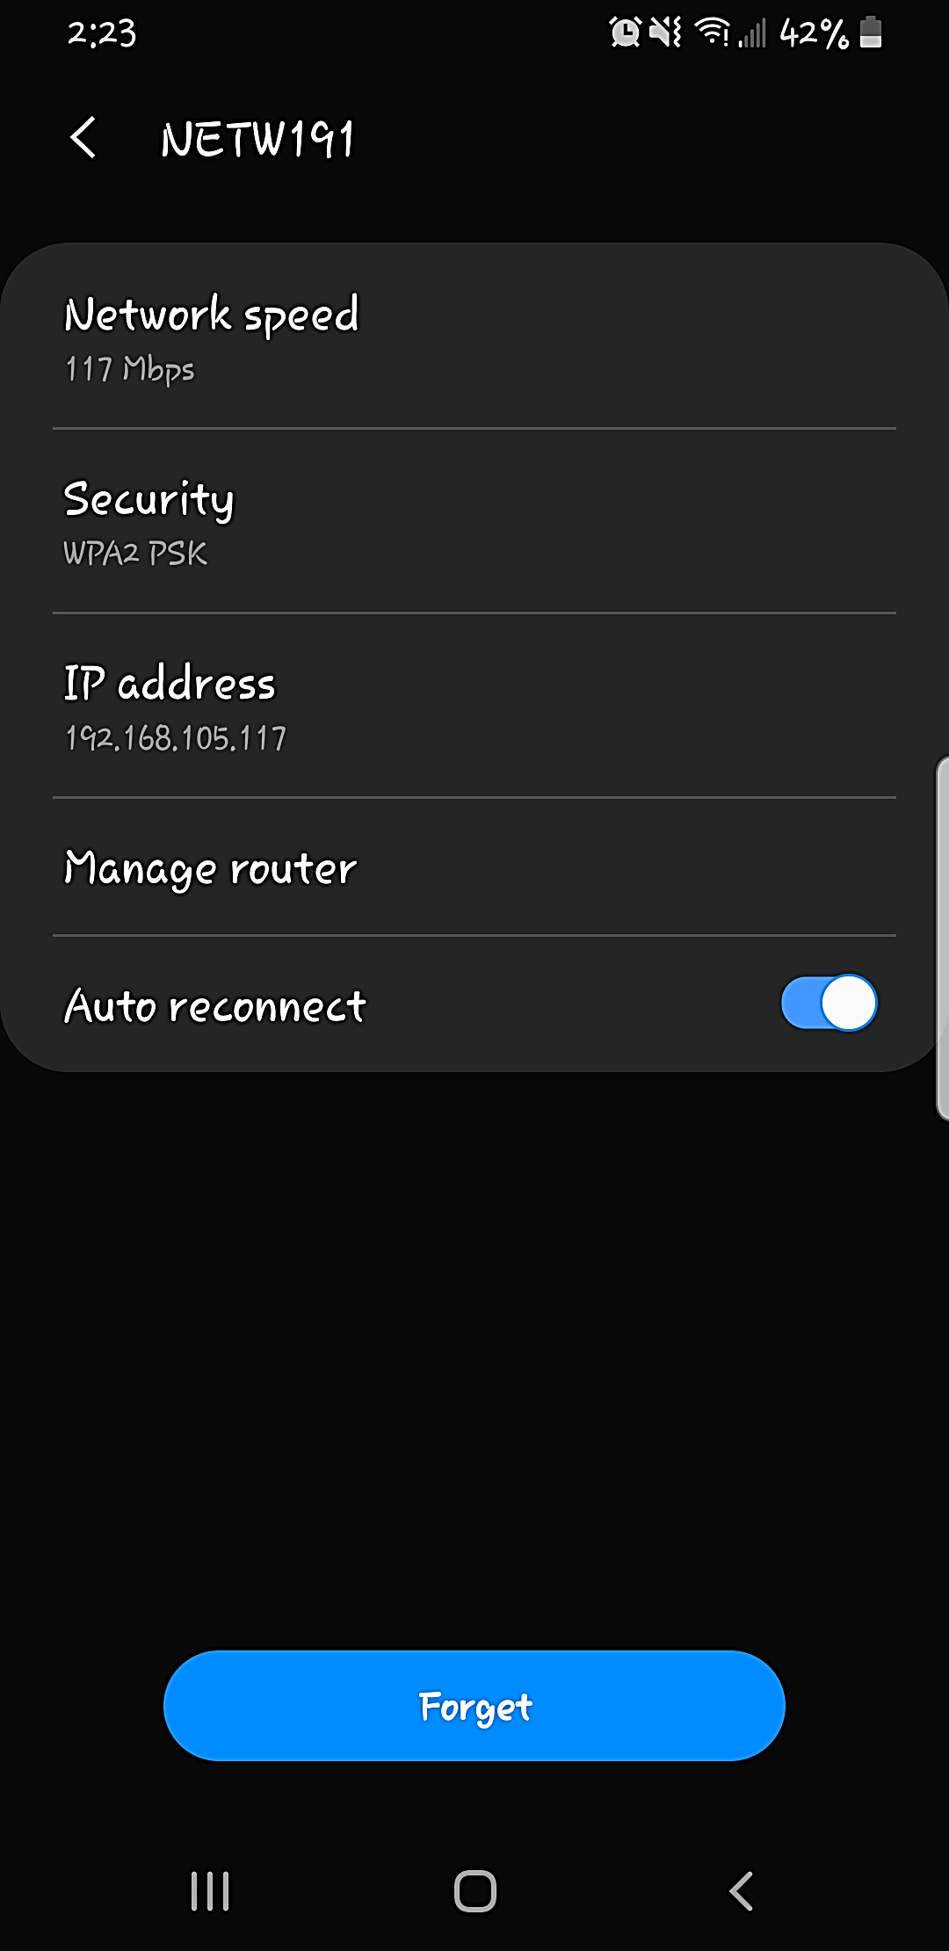
Wi-Fi Client
IP Address
This screenshot shows the IP address of my Wi-Fi device (smartphone) that’s associated with the NETW191 network.

Slide 26
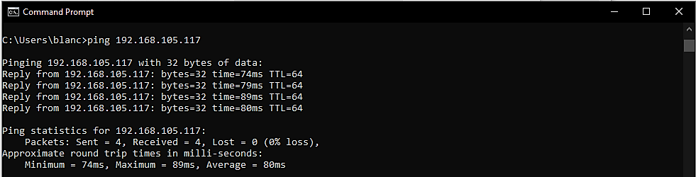
Ping Test
This screenshot shows a successful ping test from the host computer to my Wi-Fi device that’s associated with the NETW191 network.

Slide 27
What was learned in this module…
Creating a network SSID and password to gain access.
Checking the Wi-Fi connection to a basic network after the configuration of the set identifier.
Identifying the network SSID and its IP address.

Slide 28
Conclusion…
This course has provided me enough information to learn the inner workings of the internet connection, and how IP addresses are utilized. It was quite difficult to understand at first, but I am glad to learn the functions and configurations hands on. I would highly recommend this class to others who are interested in learning and pursuing Information Technology and Networking.

Slide 29
Thank you!
Feedback is most welcome!

