Slide 1

Introduction to Digital Devices Portfolio
Blanche Perez
DeVry University
CEIS114

Slide 2

This Portfolio Contains:
Introduction
Modules
What was learned in each module
Conclusion

Slide 3
Introduction: What are digital devices?
A device or microcontroller contained in a physical unit of equipment. A smartphone, laptop, and smartwatch are only a few of the digital technologies available today. Non-digital (analog) instruments, such as a thermometer, electric fan, and wheelchair, are examples of non-digital (analog) devices. Automobiles, washing machines, and a variety of other items are digital and analog in nature.

Slide 4

Module 2: Project Plan for IoT Traffic Controller
In this module, we must create a two-way traffic light controller with a pedestrian crossing and an emergency signal by designing and developing it. An LCD display at the pedestrian crossing will indicate whether the pedestrian can or cannot cross the street. When they are about to cross, the LCD will count down from ten (10) to zero (0), showing how much time they have.

Slide 5
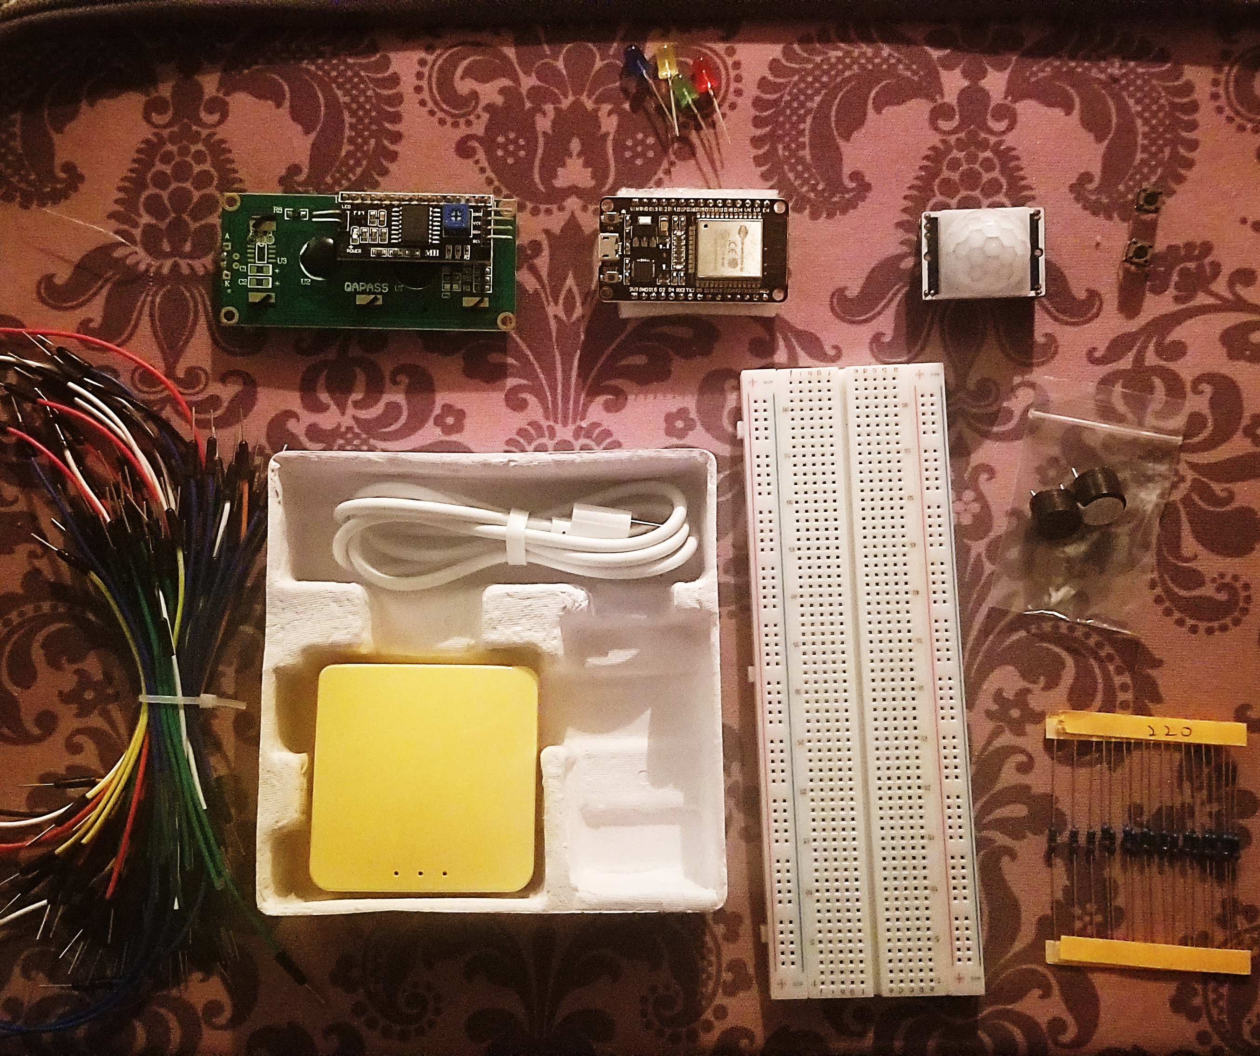
Inventory (Picture)
ESP 32 Board
Colored LEDs: Red, Yellow, Green, and Blue
220 Ohm Resistors (optional)
Wires
Breadboard(s)
LCD Unit with I2C Adapter
Active Buzzer
Mini Router
Push Button(s)
PIR Motion Sensor

Slide 6
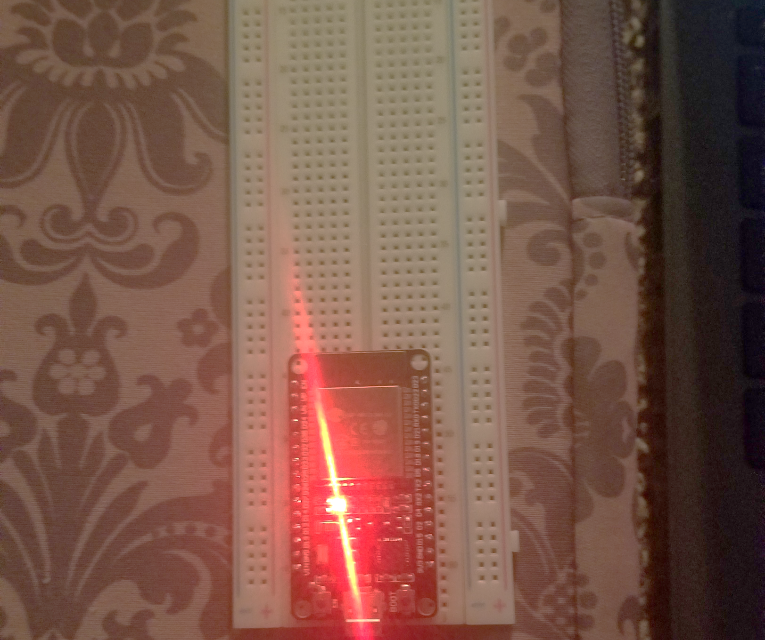

ESP32 (Picture)
Microcontroller mounted and powered ON.

Slide 7
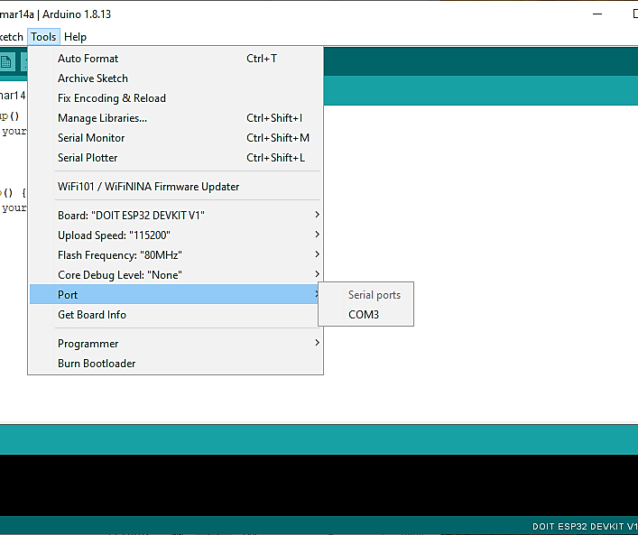
Installation of Arduino IDE
Screenshot of Arduino IDE with Port selected from Tools menu.

Slide 8
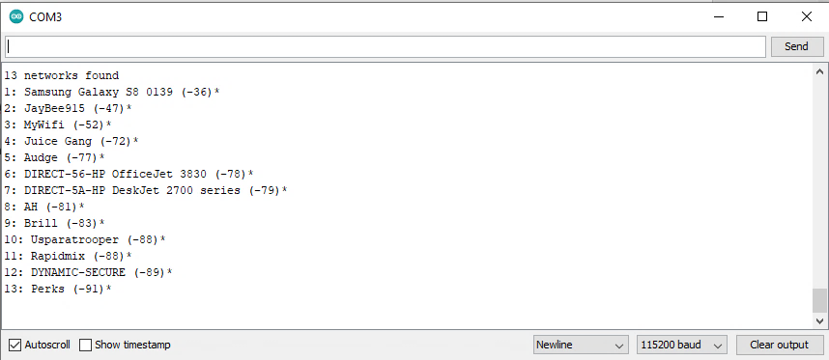
ESP32 WiFi Scan
Screenshot of Serial Monitor in Arduino IDE showing the available networks.

Slide 9
What was learned in this module…
Learning the functions of the code given.
Learning the functions of a specific piece of hardware in the inventory (i.e., resistor, ESP32 microcontroller, etc.).

Slide 10
Module 3: Creating the Traffic Controller
In this module, this section of the project's goal is to run a program that simulates a traffic light controller. We had to start by controlling a single LED light, then progress to controlling three LEDs to simulate a single traffic light.

Slide 11
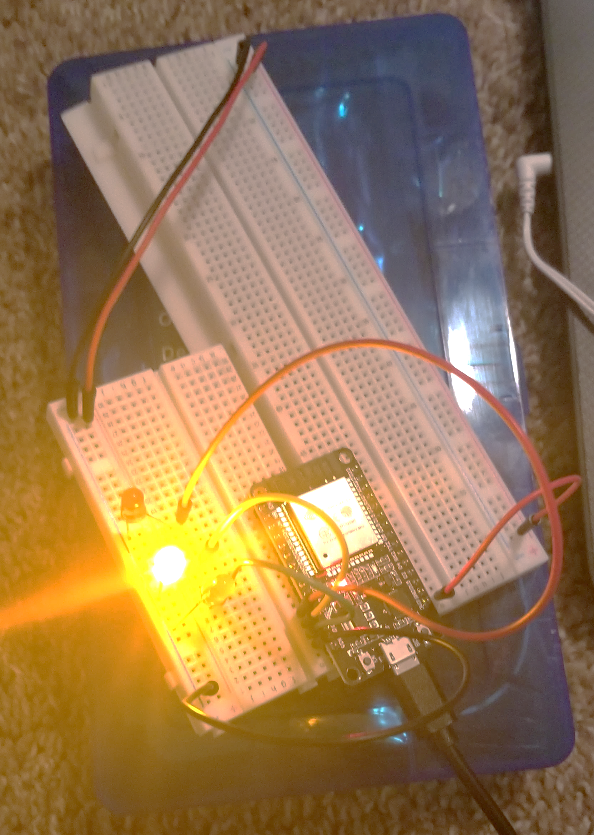
Picture of circuit with working LEDs
ESP 32 Board
Colored LEDs: Red, Yellow and Green
220 Ohm Resistors (optional)
Wires
Breadboard

Slide 12
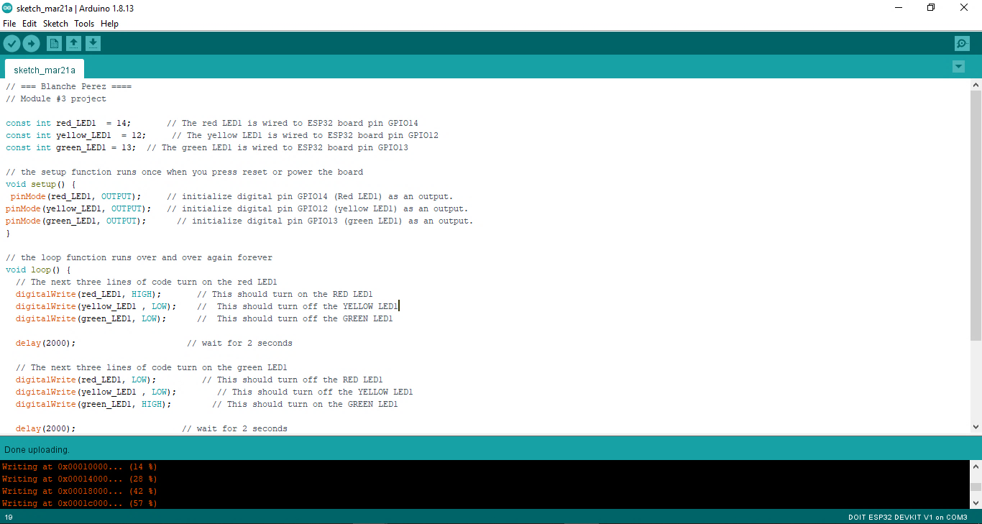
Screenshot of code in Arduino IDE
Screenshot of code in Arduino IDE showing my name in the comment.

Slide 13
What was learned in this module…
Learning the functions of the code and how it processes data to that device.
Learning how to make the device work using the given code.

Slide 14
Module 4: Creating a Multiple Traffic Light Controller
In this module, we have added 3 more LED lights and learning how to make all six lights function; simply by entering another code in Arduino.

Slide 15



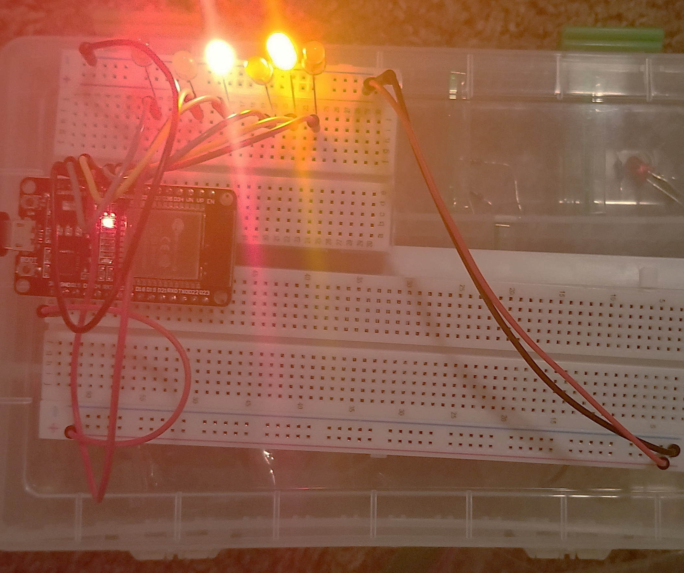

Picture of circuit with working LEDs
ESP 32 Board
Colored LEDs: Red, Yellow and Green (two sets)
220 Ohm Resistors (optional)
Wires
Breadboard

Slide 16
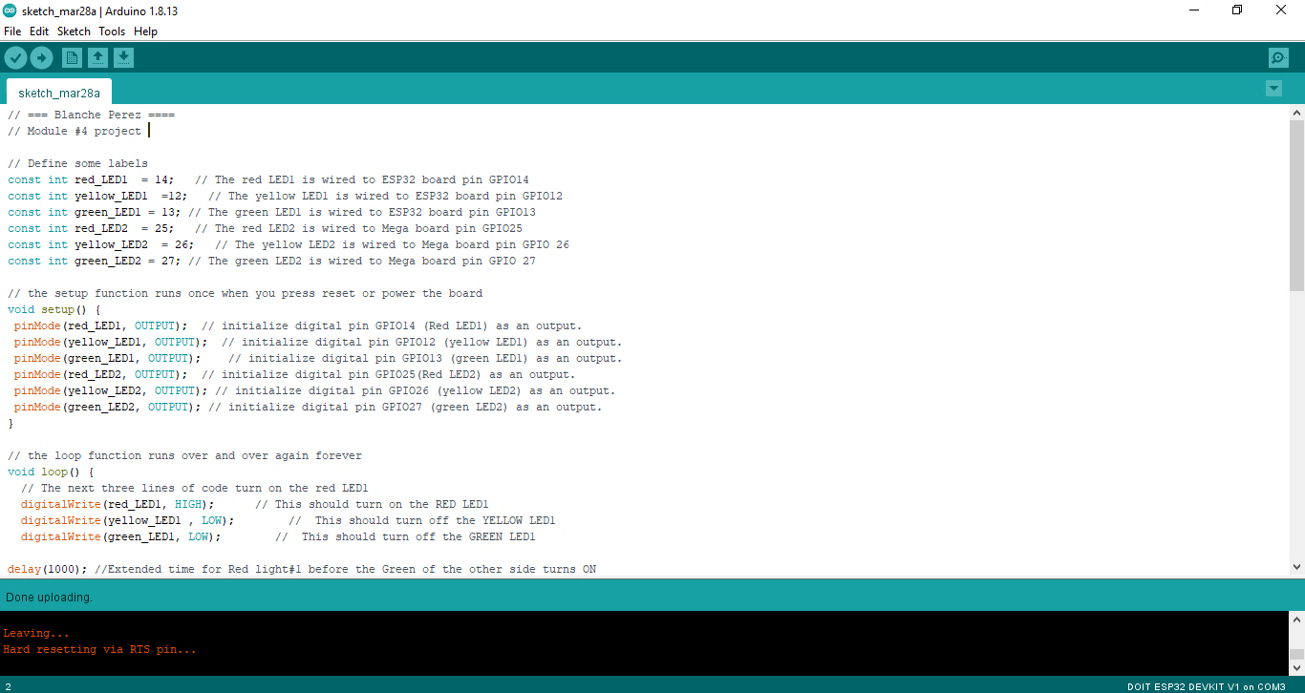

Screenshot of code in Arduino IDE
Screenshot of code in Arduino IDE showing my name in the comment.

Slide 17
What was learned in this module…
Figuring out how to function more than three LEDs with a proper usage of the code given.
Using more than one breadboard to create an IoT device made for processing data to make it function properly.

Slide 18
Module 5: Creating a Multiple Traffic Light Controller with a Cross Walk
In this module, learning how to control the traffic light with a push button function is tested. (Plenty of troubleshooting was required here.)

Slide 19


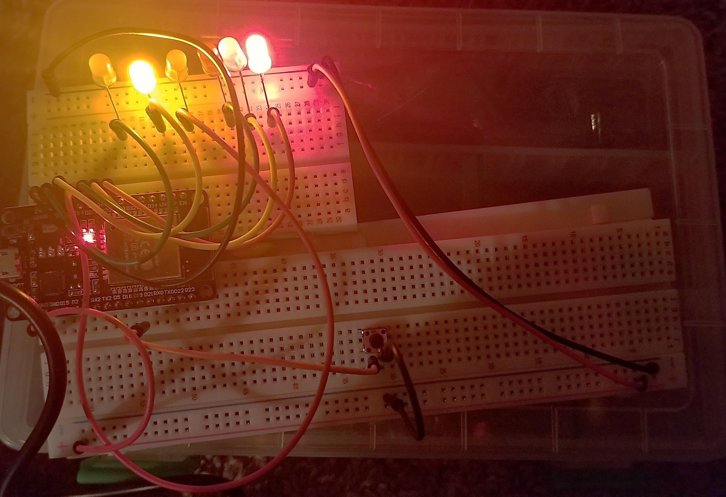

Picture of circuit with working LEDs
ESP 32 Board
Colored LEDs: Red, Yellow and Green (two sets)
220 Ohm Resistors (optional)
Push Button
Wires
Breadboard

Slide 20
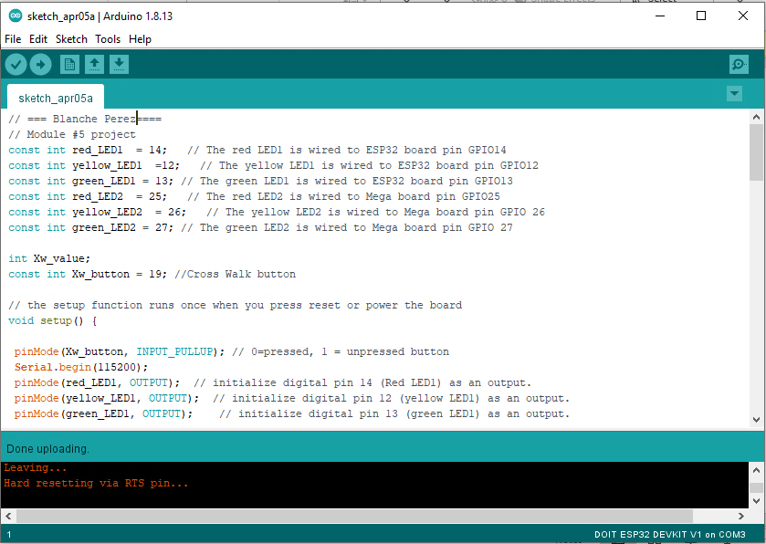
Screenshot of code in Arduino IDE
Screenshot of code in Arduino IDE showing my name in the comment.

Slide 21
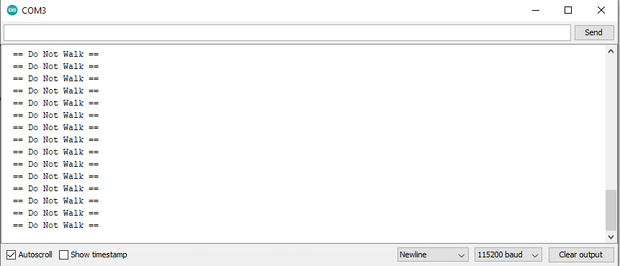
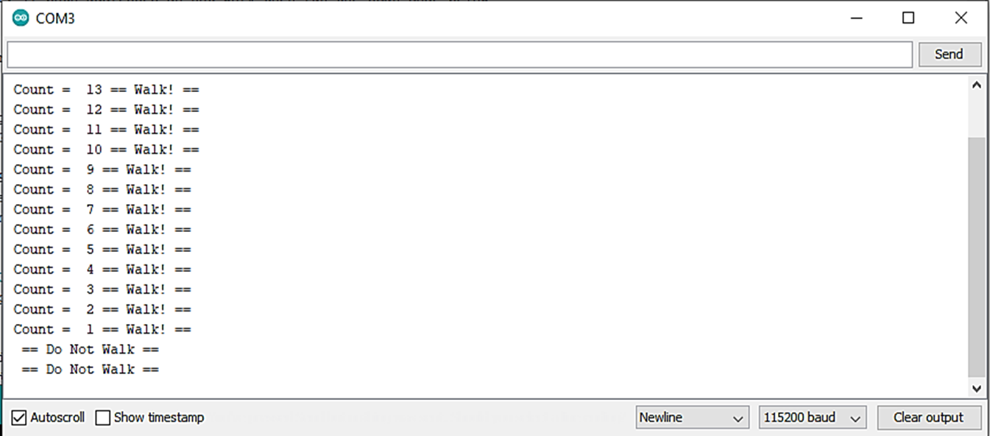
Screenshot of Serial Monitor in Arduino IDE
No push button function
Screenshot of output in Serial Monitor.
With push button function

Slide 22
What was learned in this module…
To troubleshoot the issue with the push button function.
Knowing when the cross-walk function switches when using the Arduino serial monitor.

Slide 23
Module 6: Creating a Multiple Traffic Light Controller with a Cross Walk and an Emergency Buzzer
In this module, we must install the LiquidCrystal_I2C-master Library in the Arduino IDE to put the LCD monitor to use. (There was plenty of troubleshooting here, as well.)

Slide 24



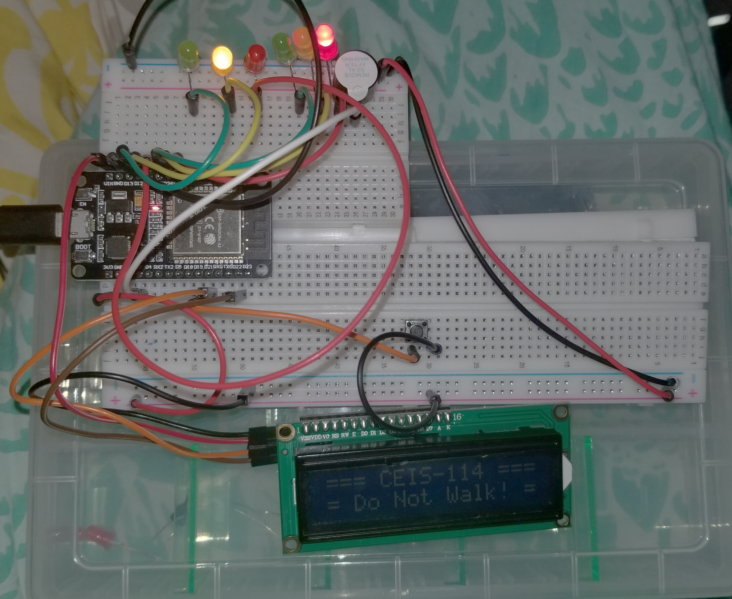
Picture of circuit with working LEDs and LCD display
ESP 32 Board
Colored LEDs: Red, Yellow and Green (two sets)
220 Ohm Resistors (optional)
Push Button
LCD Unit with Message Display
Wires
Breadboard
Note: I had tried to figure out the LCD display backlight, but I probably have a faulty.

Slide 25
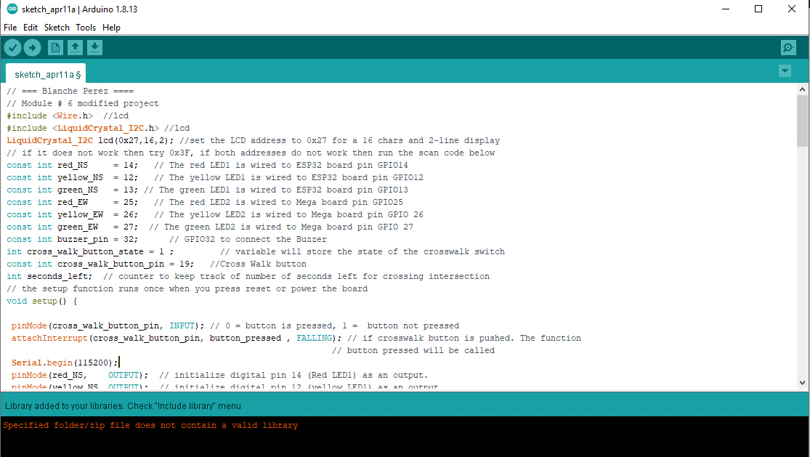
Screenshot of code in Arduino IDE
Screenshot of code in Arduino IDE showing my name in the comment.

Slide 26
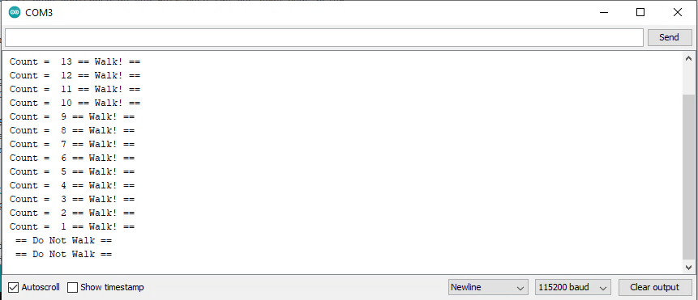
Screenshot of Serial Monitor in Arduino IDE
Screenshot of output in Serial Monitor.

Slide 27
What was learned in this module…
Reading the LCD sign when it switches using the cross-walk function.
To switch the dial to adjust LCD (if needed).
Using the serial monitor in Arduino to observe the cross-walk function.

Slide 28
Conclusion…
Throughout the past 7 weeks of learning more about the Internet of Things (IoT), it has been quite the labyrinth to know about how digital devices work. From as knowing the functions of what makes a digital device work, to learning about the small parts that make the digital device function. The biggest challenge here is the project was difficult to figure out. Plenty of troubleshooting had occurred and it was rushed. I honestly feel that I could have done more better, but I am still grateful to learn more about how our devices function, and grateful to learn more in the near future.

Slide 29
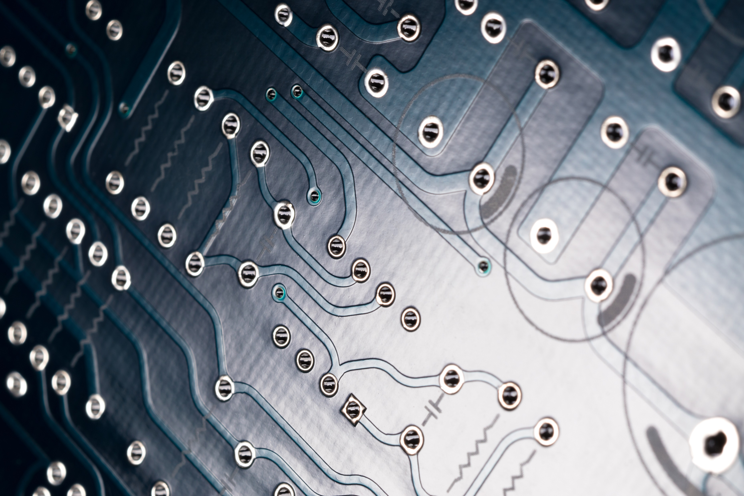
Thank you!
Feedback is welcome!

