Slide 1

Fundamentals of Cloud Computing
Blanche Perez
DeVry University
NETW211

Slide 2
This Portfolio Contains…
Introduction
Modules
Skills learned in each module
Conclusion (What was learned)

Slide 3
Introduction – What is Cloud Computing?
Cloud computing is the supply of computer services such as servers, storage, databases, networking, software, analytics, and intelligence over the Internet (“the cloud”) in order to provide faster innovation, more flexible resources, and economies of scale. In Module 1, we were introduced to AWS (Amazon Web Services). It is the world's most complete and widely used cloud platform, providing over 200 fully featured services from data centers around the world.

Slide 4
Module 2: Virtual Machine (VM) Instances
This module has introduced us to Amazon's Elastic Computing Cloud (EC2) service, which delivers safe and scalable computing capacity in the cloud. The following are the duties that had to be completed:
Launching an EC2 instance.
Adding a connection to the instance.
How the instance can be terminated.

Slide 5
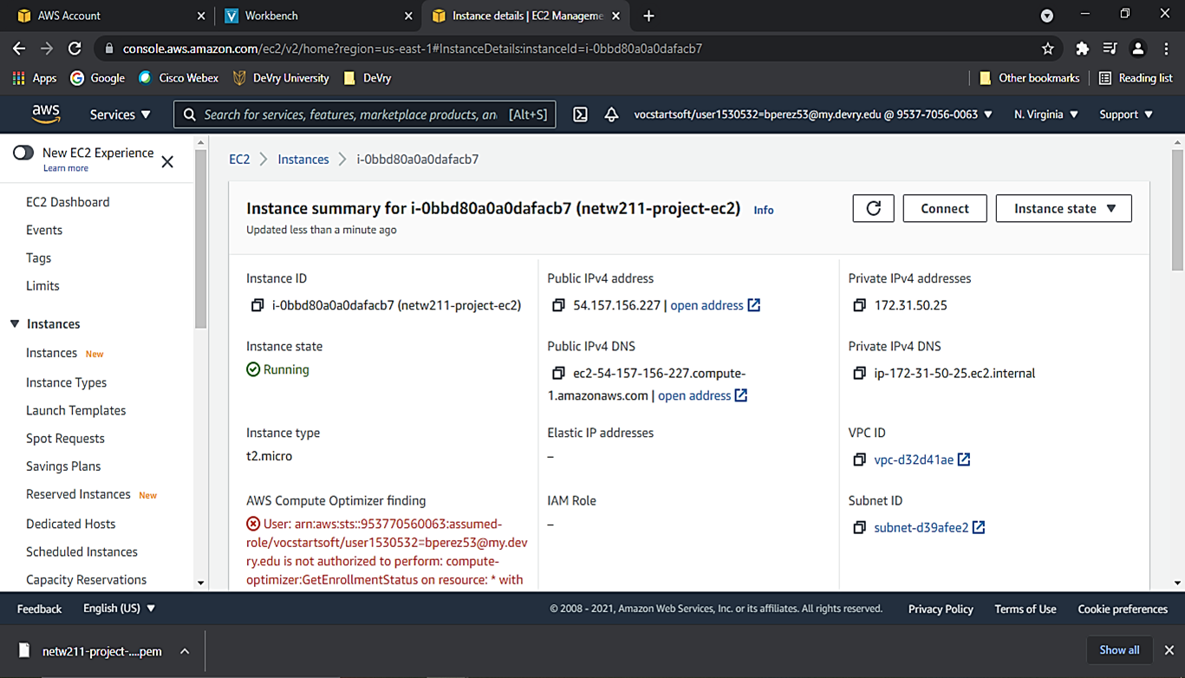
Launching an EC2 instance
This screenshot shows the instance summary page with the information about the instance.

Slide 6
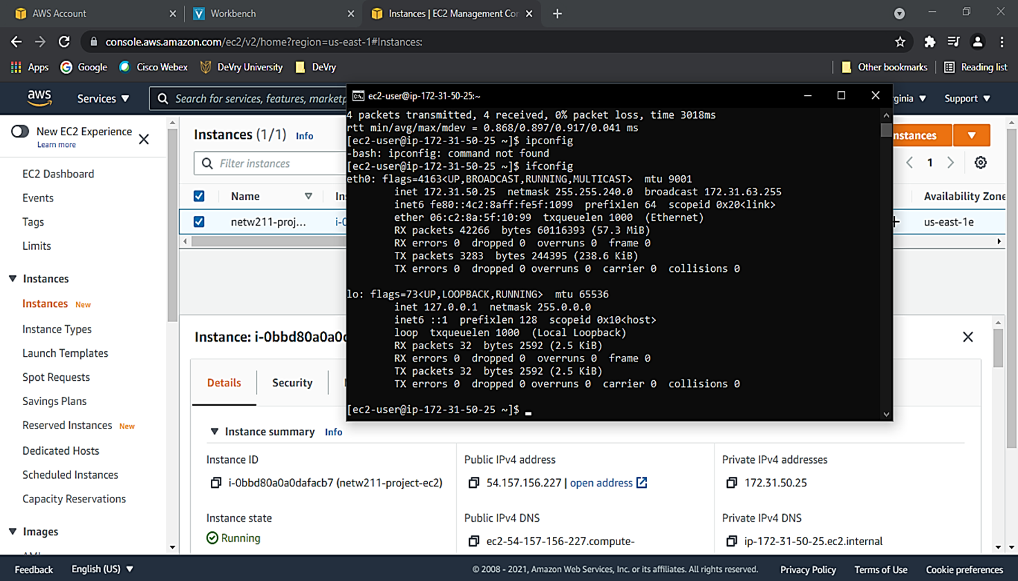
Connecting to the instance
This screenshot shows the Command Prompt window with the instance’s IPv4 address being displayed.

Slide 7
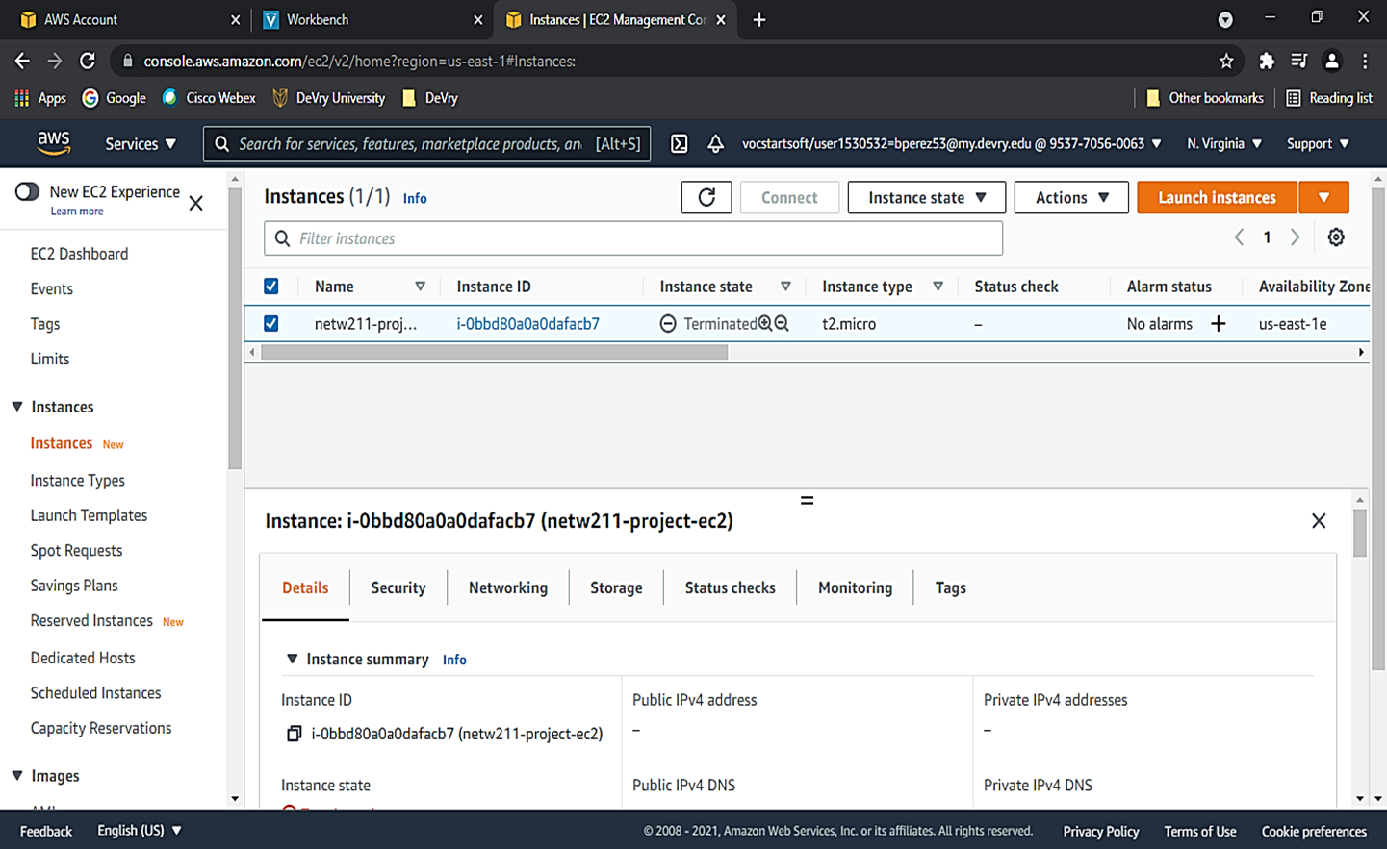
Terminating the instance
This screenshot shows the Instances page with the instance name and its state as terminated.

Slide 8

What skills were learned?
Learning to configure and launch instances, using the Amazon Web Services (AWS).
Connecting to instances and utilizing the command prompt to display their IP addresses.
Learning how to terminate an instance.

Slide 9
Module 3:Virtual Private Cloud (VPC)
This module will introduce you to Amazon Virtual Private Cloud (VPC). Customers may use this service to create a conceptually isolated portion of the AWS Cloud and launch AWS services into a virtual network.

Slide 10
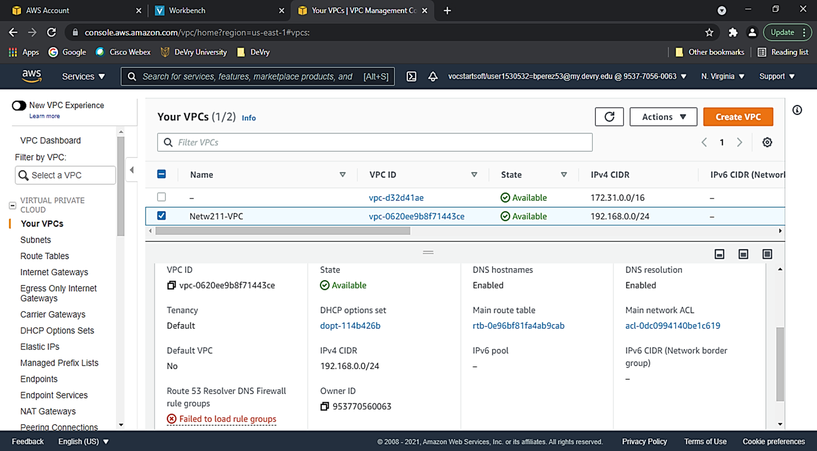
Launching a VPC with a single subnet
This screenshot shows the dashboard with the information about the VPC.

Slide 11
Questions
1. With a /26 network prefix, how many usable IPv4 addresses are there? Why is the number of available IPv4 addresses HERE shown as 59?
Answer: There are 64 usable IP addresses available with a /26 network prefix; there are only 59 IPv4 addresses because this is the maximum number of useable IP addresses that may be set by the host.
2. What’s the role of an Internet Gateway?
Answer: An internet gateway provides two functions: it acts as a target in your VPC route tables for internet-routable traffic and it performs network address translation (NAT) for instances with public IPv4 addresses (Amazon, 2021).
References:
1. RIPE NCC. 2019, August 9. Classless Inter-Domain Routing (CIDR) Chart. Ripe Network Coordination Centre. https://www.ripe.net/about-us/press-centre/understanding-ip-addressing
2. Amazon. 2021. Internet Gateways. Amazon Web Services. https://docs.aws.amazon.com/vpc/latest/userguide/VPC_Internet_Gateway.html

Slide 12
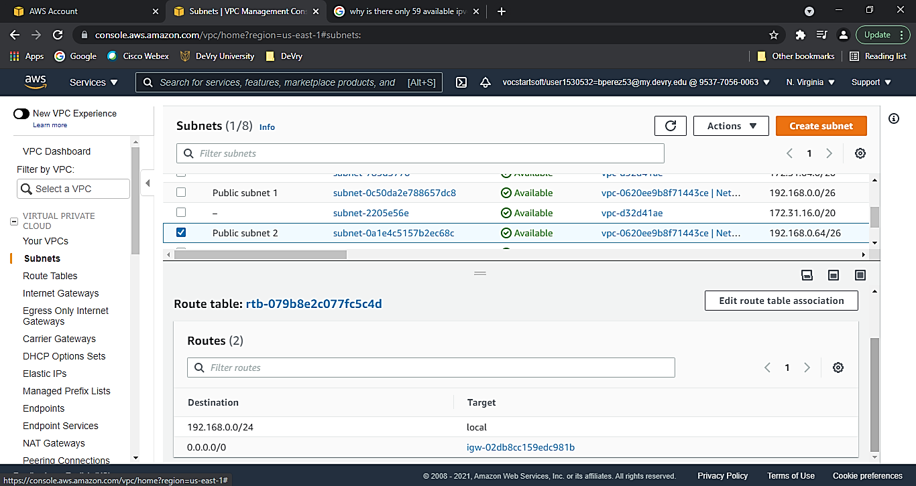
Adding another subnet
This screenshot shows the dashboard with two subnets and the route table of public subnet 2.

Slide 13
What skills were learned?
Utilizing a VPC to add one or more subnets.
Investigating subnets and route tables.
Create and configure another subnet.

Slide 14
Module 4: VM Instance Security
This module has introduced us to Amazon Virtual Private Cloud (VPC). Customers may use this service to create a conceptually isolated portion of the AWS Cloud and launch AWS services into a virtual network.

Slide 15
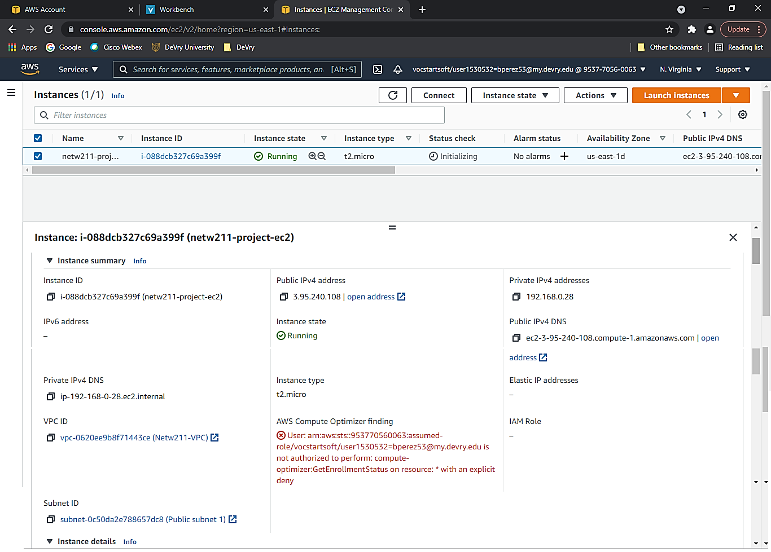
Launching an EC2 instance
This screenshot shows the Details section of the EC2 instance.

Slide 16
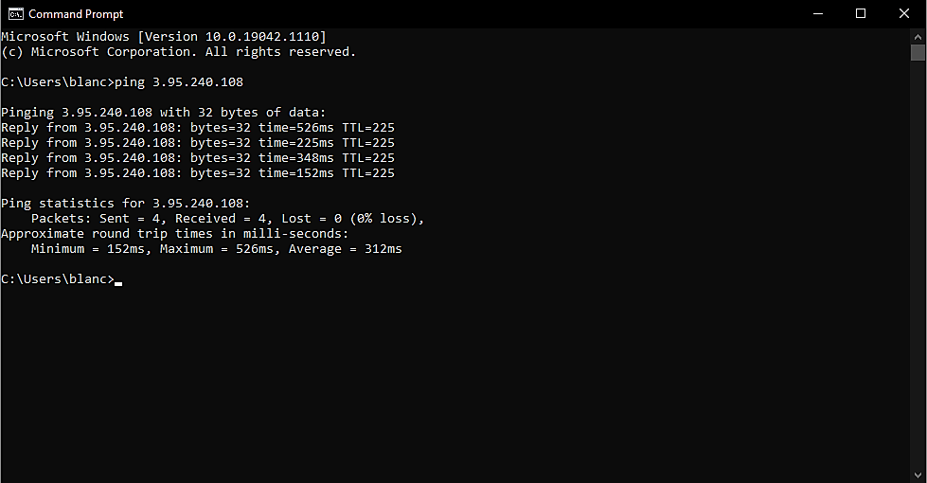
Setting up a security group
This screenshot shows the successful ping from the main computer to the instance in the cloud.

Slide 17
What skills were learned?
Learning to configure and create a security group.
Using critical thinking to investigate how a security group functions.

Slide 18
Module 5: Cloud Storage
In this module, we learned about Amazon's Simple Storage Service (S3). S3 is an object storage service that is used to store and secure data for applications such as mobile apps, websites, backups, IoT devices, and big data analytics.

Slide 19
Question
What does the default encryption do?
Answer: Data encryption is a method of protecting data by encoding it. A password or an encryption (cypher) key, as well as specific encryption techniques, are used to encrypt data. Using the right password or encryption (decryption) key, the encrypted data may then be accessed (Bose, 2020). According to AWS, set the default encryption behavior for an S3 bucket so that all new changes published in the bucket are encrypted. Amazon S3 encrypts an item before saving it to disk and decrypts it when you download the objects when you utilize server-side encryption.
References:
1. Bose, Michael. 2020, June 17. How to Secure S3 Objects with Amazon S3 Encryption. Nakivo. https://www.nakivo.com/blog/amazon-s3- encryption-configuration-overview/
2. AWS. 2021. Setting default server-side encryption behavior for Amazon S3 buckets. Amazon Web Services. https://docs.aws.amazon.com/AmazonS3/latest/userguide/bucket- encryption.html

Slide 20
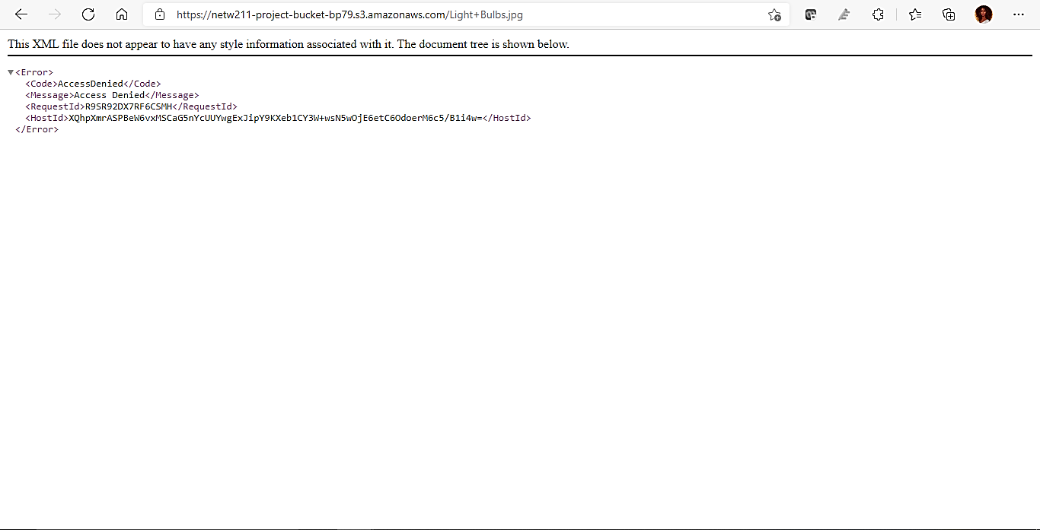
Uploading a file
This screenshot shows the “Access Denied” error message in a browser window.

Slide 21
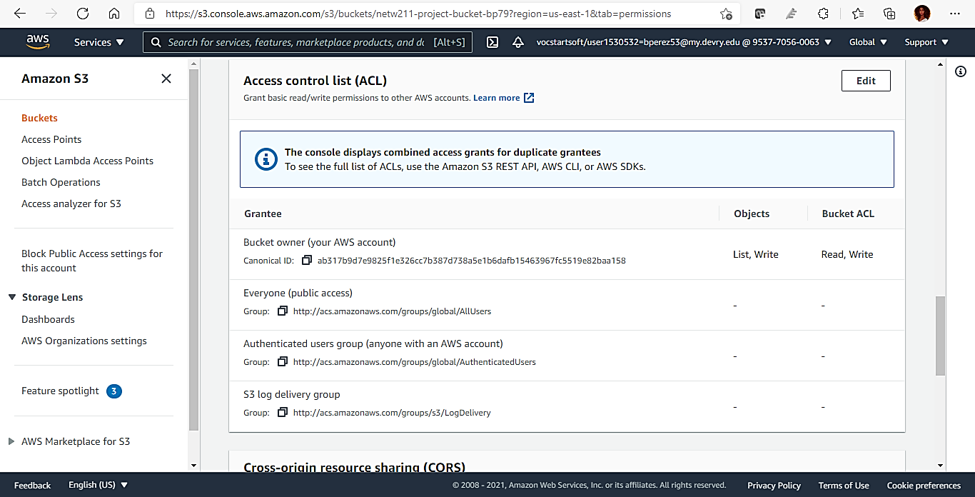
Changing Permissions
This screenshot shows the permissions or access control list (ACL) information of the uploaded file.

Slide 22
What skills were learned?
Learn to create storage buckets to backup files.
Uploading the files into the bucket.
Knowing how to configure the file changes and permissions.

Slide 23
Module 6: Cloud Monitoring
In this last module, the lesson introduced us to Amazon Simple Notification Service (SNS), a managed pub/sub messaging tool, and Amazon CloudWatch, a monitoring and management service.

Slide 24
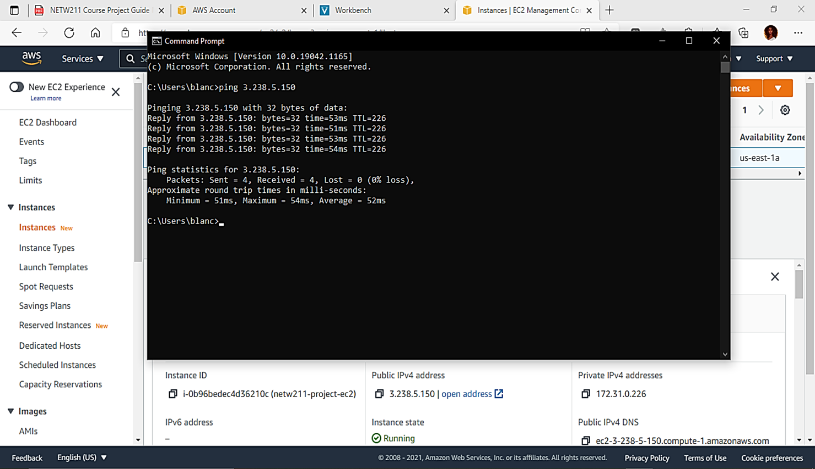
Launching an EC2 instance
This screenshot shows the successful ping from the local computer to the EC2 instance.

Slide 25
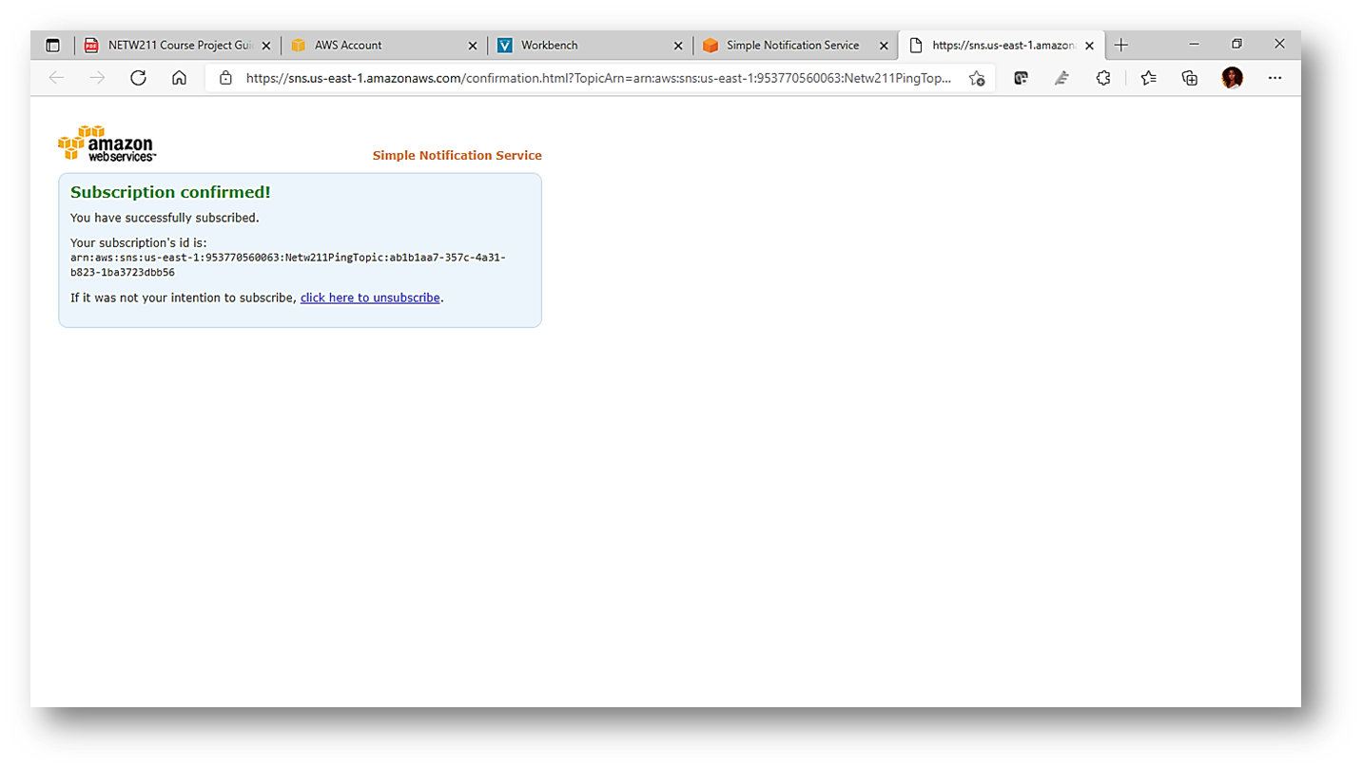
Setting up SNS notification and subscription
This screenshot shows the browser window with the “Subscription confirmed!” message (not the email!).

Slide 26
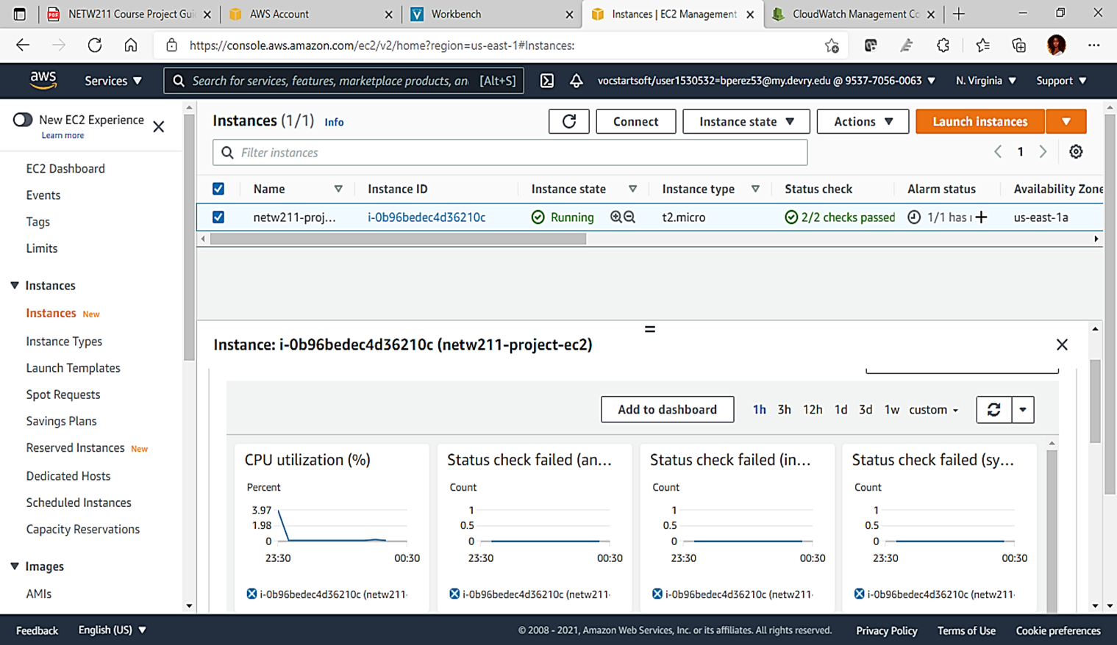
Setting up a CloudWatch alarm
This screenshot shows the EC2 dashboard with several CloudWatch metrics.

Slide 27
What skills were learned?
Sending SNS notifications and subscription to e-mail.
Create and configure a CloudWatch alarm.
Deleting/terminating cloud resources.

Slide 28

What was learned in the course?
Cloud computing is a new experience for those who have not seen or tried it. It is a challenge to solve how a cloud service works. Its functions vary in many types of fields, from a Virtual Machine Instance to cloud monitoring. I hope to utilize this unique knowledge in the future.

Slide 29

Thank you!
Feedback is welcome!

