Slide 1

Fundamentals of Information System Security
Blanche Perez
DeVry University
SEC285

Slide 2

This Portfolio Contains…
Introduction
Modules
What skills were learned in each Module
Conclusion (What was learned in the course)

Slide 3
What is Information System Security?
Also known as INFOSEC, it is a wide subject within the area of information technology (IT) that focuses on the safety of computers, networks, and their users.
In Module 1, we were introduced to Microsoft Azure.
  Learning how to access the main Virtual Machine and utilizing three other VMs:
    Linux Server
    Kali (VM)
    Ubuntu

Slide 4
Module 2: Asymmetric Key Encryption
In this module, we emulate a Linux administrator to adopt different best practices to mitigate security vulnerabilities, such as the ones listed below.
Turn off unneeded services.
Improve user management.
Use a stateful firewall to restrict access to only authorized hosts.
Improve network time management and tracking.
Set up an efficient patch management system.
Encrypt data while it is at rest and in transit.
Make server activity logging mandatory.
Put in place security safeguards to guard against dictionary and brute force attacks.
Enforce forensic file destruction.

Slide 5
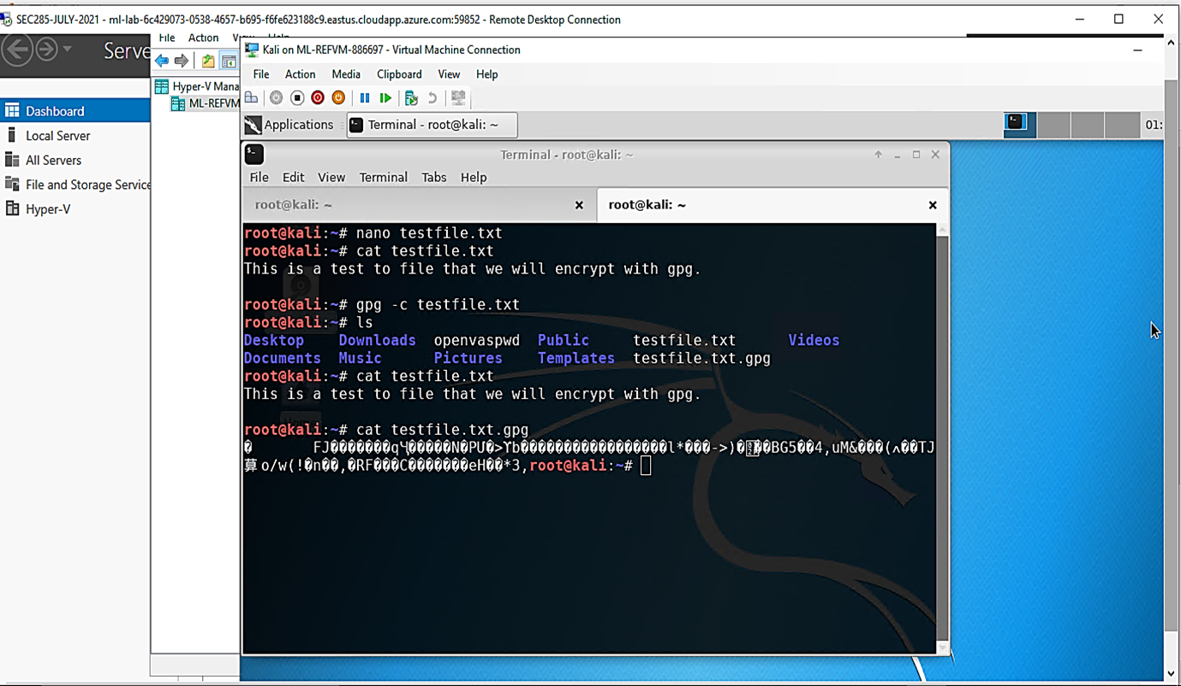
File Encryption
This screenshot shows the following.
Content of the plaintext file
Content of the encrypted file

Slide 6
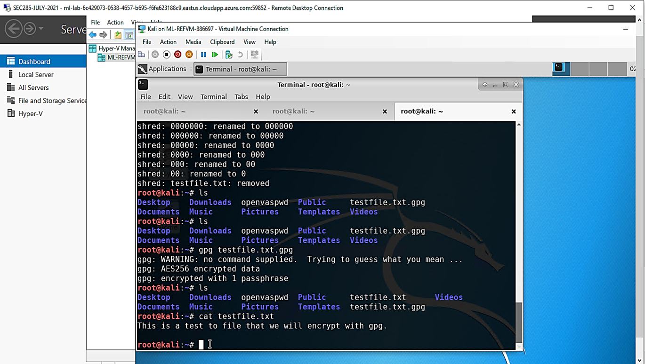
File Decryption
This screenshot shows the following.
The encrypted file being listed by itself
The decrypting process
Both the encrypted file and the original plaintext file being listed

Slide 7
What skills were learned?
Investigating how to utilize symmetric and asymmetric encryption standards and tools to protect important documents.
Deleting/terminating files once after the encryption process has been completed.

Slide 8
Module 3: Stateful Firewall
In this module, we will look at how a firewall may be used to secure enterprise computer resources from cyber attacks.

Slide 9
Question
What effect does the sudo iptables --policy INPUT DROP command have on the access to computing resources?
Answer: You should modify the default policy of your chains to drop if you prefer to refuse all connections and explicitly specify which ones you wish to allow to join. This would most likely only be helpful for servers that store sensitive data and only have the same IP addresses connecting to them (Brown, 2020). When the default policy for both the INPUT and OUTPUT chains is DROP, you need make 2 rules for each firewall rule requirement; one for receiving and one for outgoing, for example.
References:
Brown, Korbin. 2020, August 27. The Beginner’s Guide to iptables, the Linux Firewall. How-To Geek. https://www.howtogeek.com/177621/the-beginners-guide-to-iptables-the-linux-firewall/
Natarajan, Ramesh. 2011, June 14. 25 Most Frequently Used Linux IPTables Rules Examples. The Geek Stuff. https://www.thegeekstuff.com/2011/06/iptables-rules-examples/

Slide 10
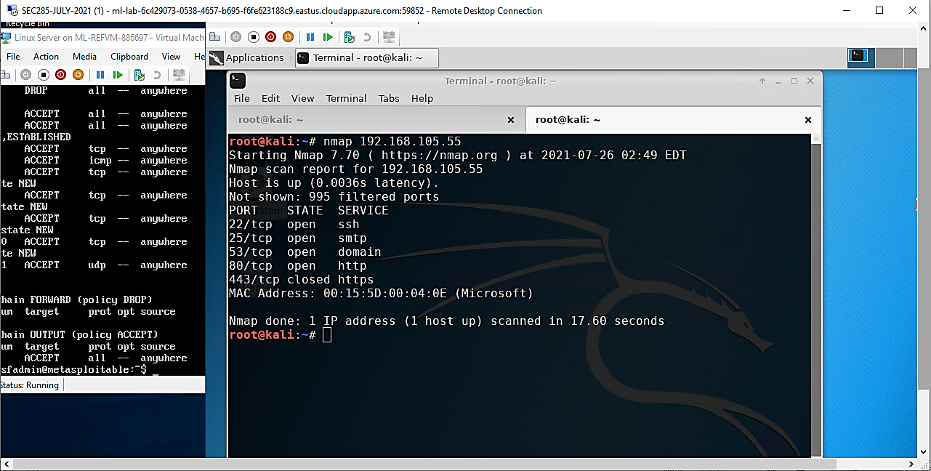
Nmap Scan
This screenshot shows the Nmap scan result of the Linux Server VM.

Slide 11
What skills were learned?
Communicating with knowledge to know a specific function of a command.
Learning how to use the Nmap command to scan for results for a certain Virtual Machine (VM) (i.e., Linux).

Slide 12
Module 4: Bring Your Own Device (BYOD)
Security Policy
In this module, we had to create our own BYOD policy in a company-based scenario. A BYOD an IT policy that enables, and sometimes promotes, workers to access corporate data and systems via personal mobile devices such as cellphones, tablets, and laptop computers. BYOD has four fundamental choices or access levels: Personal devices have unrestricted access.

Slide 13
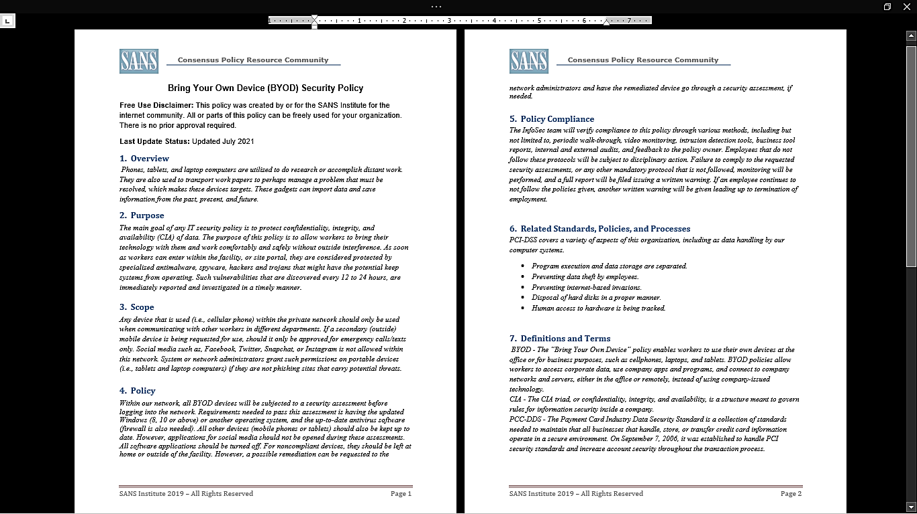
BYOD Security Policy

Slide 14
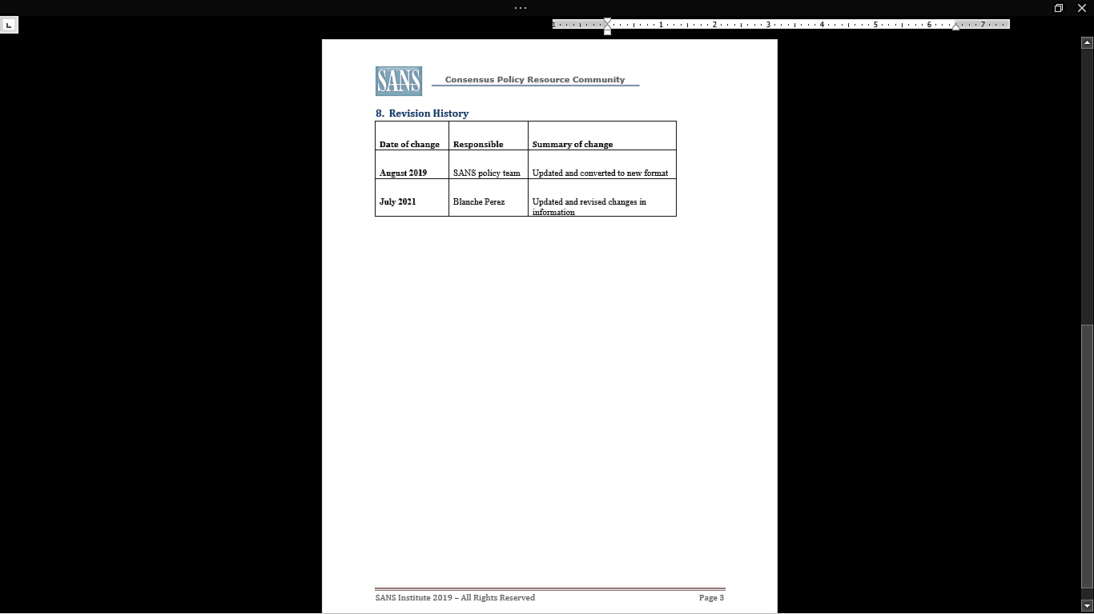
BYOD Security Policy (continued)

Slide 15
What skills were learned?
Using critical thinking and research to produce fair and professional policies for employees.
Utilizing a scenario of being a manager/supervisor to present these policies to employees.

Slide 16
Module 5: Multifactor Authentication (MFA)
In this module, we used multifactor authentication to build security measures to manage enterprise computing resources (MFA).

Slide 17
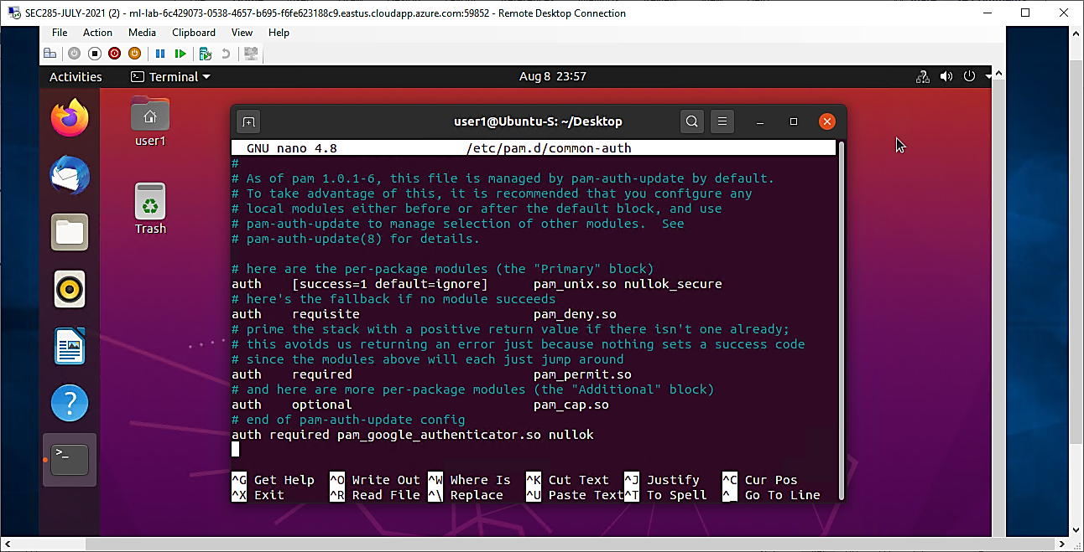
Common-auth Configuration File
This screenshot shows the entry that indicates the use of the Google Authenticator module.

Slide 18
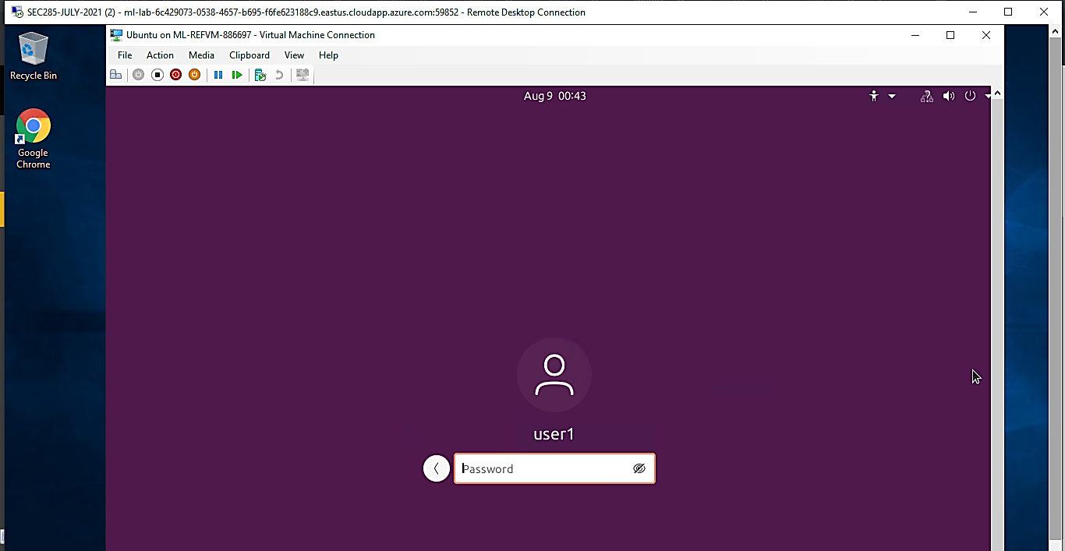
MFA Logon Screen
This screenshot shows the logon screen where a verification code is required.

Slide 19
What skills were learned?
What it is like as a Linux administrator to utilize an authenticator to access VM ware from another device.

Slide 20
Module 6:
Vulnerability Assessment
In this last module, we have explored and utilized three vulnerability assessment tools, including Nessus.
NMAP - The NMAP tool may be used to find IP addresses that are in use on a network segment, provided that the network segment's hosts are operational.
NetCat - The NetCat tool may be used to learn more about FTP, SSH, and SMTP apps found during an NMAP scan (called banner grabbing). Knowing the version of an application running on the server might be quite beneficial during the exploitation phase.
Wireshark - Wireshark is a packet sniffing utility. Security professionals can use it to monitor network traffic and provide insight into client and server applications.
Nessus - Nessus Essentials is a free vulnerability scanner that serves as a starting point for vulnerability analysis.

Slide 21
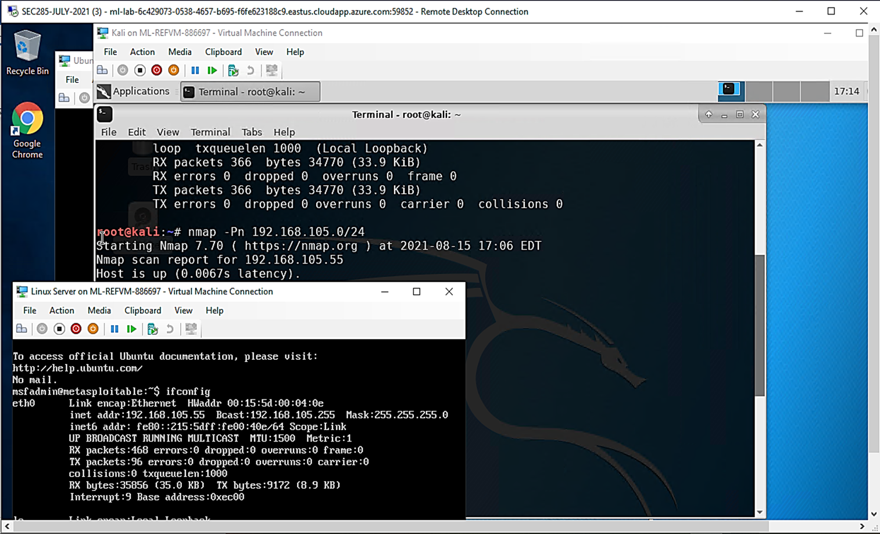
Nmap
This screenshot includes the scan result showing both the Kali and Linux Server VMs.

Slide 22
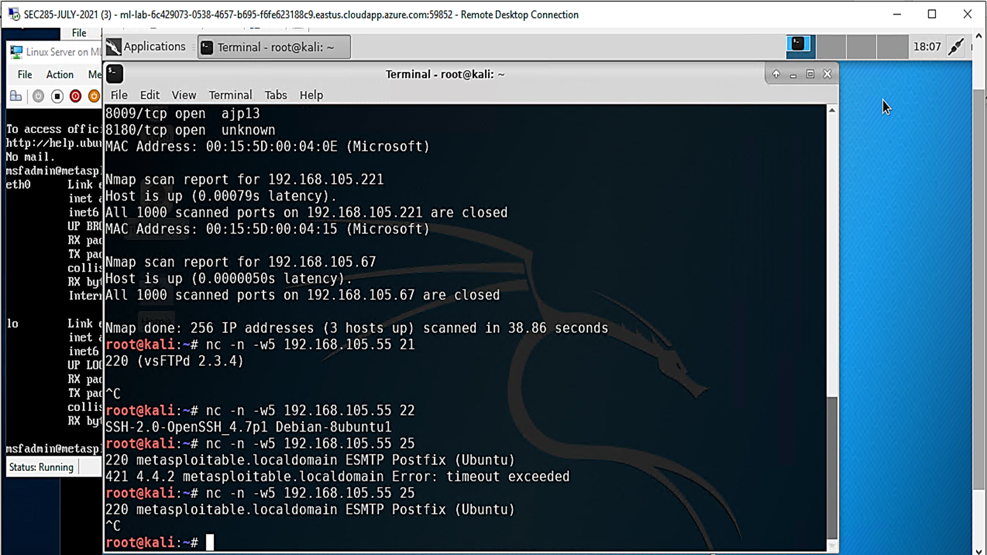
NetCat
This screenshot includes the scan result showing both the Kali and Linux Server VMs.

Slide 23
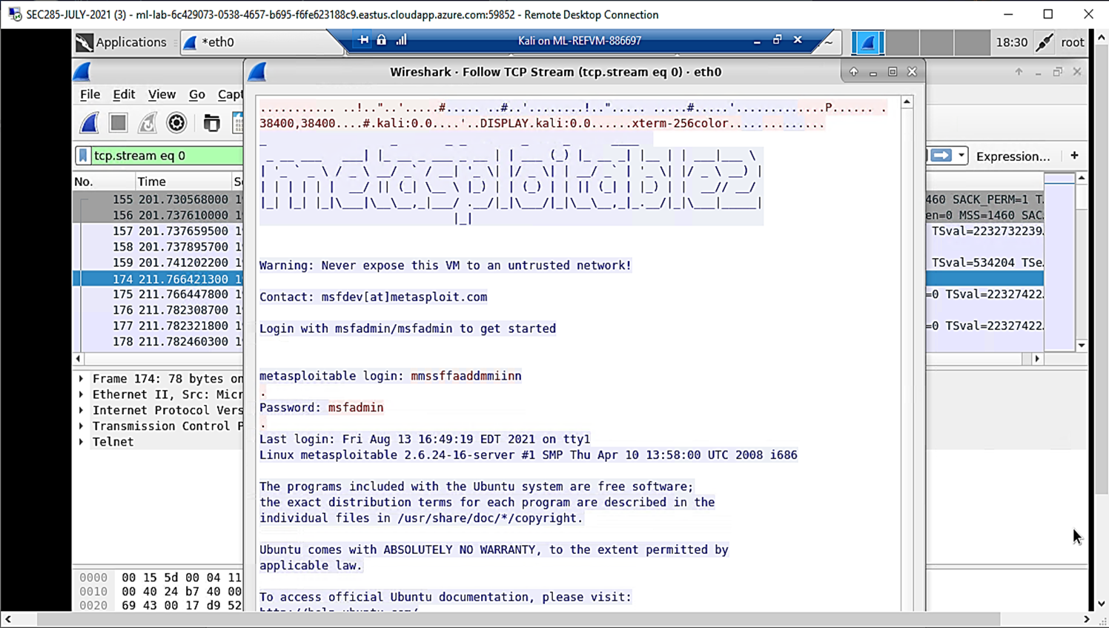
Wireshark
This screenshot includes the Wireshark—Follow TCP Steam window showing the Telnet username and password.

Slide 24
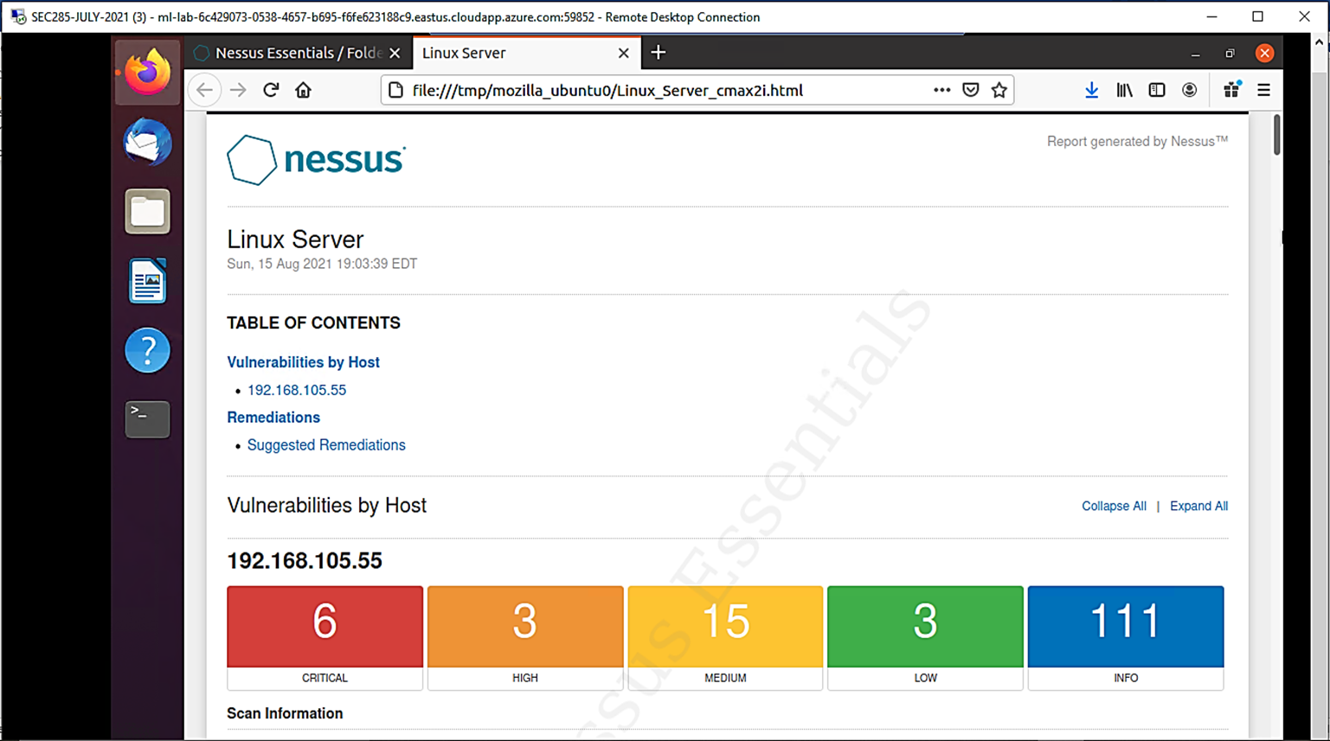

Nessus
This screenshot includes the high-level view of the Nessus vulnerability scan report (showing categories of vulnerability in different colors).

Slide 25
What skills were learned?
Gaining problem solving skills to learn how to utilize these vulnerability assessment tools.
Learning to assess the security posture of the Linux VM by launching these assessment tools via Kali VM.

Slide 26

Conclusion: What was learned in this course?
This course has increased my knowledge of what was not known within the world of IoT, and the use of system security. It has recently piqued my interest as becoming a systems administrator and studying more for the CompTIA+ Exam. System security is something new for me, however, will hopefully stay with me in the near future.

Slide 27

Thank you!
Feedback is welcome!

