Slide 1

Fundamentals of Infrastructure Security
Blanche Perez
DeVry University
SEC290

Slide 2
This Portfolio Contains…
Introduction
Modules
Skills learned in each module
Conclusion (What was learned)

Slide 3
Introduction
What is Infrastructure Security?
The process of protecting the foundational networking infrastructure through the installation of preventative measures to prevent unauthorized access, modification, deletion, and theft of resources and data is known as network infrastructure security, and it is typically used in enterprise IT environments.

Slide 4
Module 1: Manual Vulnerability Analysis
In this first Module, we examined the manual method of identifying vulnerabilities. There isn't a precise science. Vulnerabilities must be found using a variety of methods, and even then, you are only halfway there. The next step was to uncover vulnerabilities that have exploits that can deliver the access we desire.

Slide 5

What skills were learned?
Accessing VMware, such as Ubuntu.
Utilize the nmap scripting engine tools' manual mode.
Utilizing command lines to open programs, such as Metasploit.

Slide 6
Module 2: Intrusion Analysis using Wireshark
In this module, we carried out basic protocol procedures, such as:
Basic protocol analysis
Using filters to extract data
Common attacks
Basic attack analysis
On the next slide, questions were asked about the basic attacks, using Wireshark. Using certain packets as examples to understand how to analyze attacks.

Slide 7

Basic attack analysis
1. Look at captures no. 20 and 22. (You can use the “Go” link at the top of the Wireshark screen to quickly go to a specific capture) Both packets are ICMP traffic but there are subtle differences between them. Compare the time-to-live and data field sizes in the two packets. What differences do you see?
Packet 20’s time-to-live is 64, while packet 22 is 128.
Not sure, but the data in packet 20 is 56 bytes, and packet 22 is 32 bytes.
2. Do a little Internet research to discover which operating systems use the specific values in their ping commands. What operating system generated the echo request in capture 20?
The operating system for capture 20 is Linux (Ubuntu).
3. Review packet no. 37 and beyond, what do you think is taking place here?
From packet 37 and so on, a port scan is taking place. It also must identify all ports and specify them.
4. Look at capture 22846. What is suspicious about the flag settings in this packet?
1 is set on both, Acknowledgement (ACK) and Reset (RST) under “Flags”.
5. What is the IP address of the host being targeted?
The IP address being targeted is 192.168.25.1.

Slide 8
What skills were learned?
Examining network traffic and packets as they move through the network using the potent protocol analyzer, Wireshark.
Investigating the traces of various basic attacks.

Slide 9
Module 3: Open Secure Sockets Layer (SSL)
In this module, by producing and analyzing an SSL/TLS file, we had to examine manual Open SSL analysis utilizing Ubuntu Web and Wireshark.

Slide 10
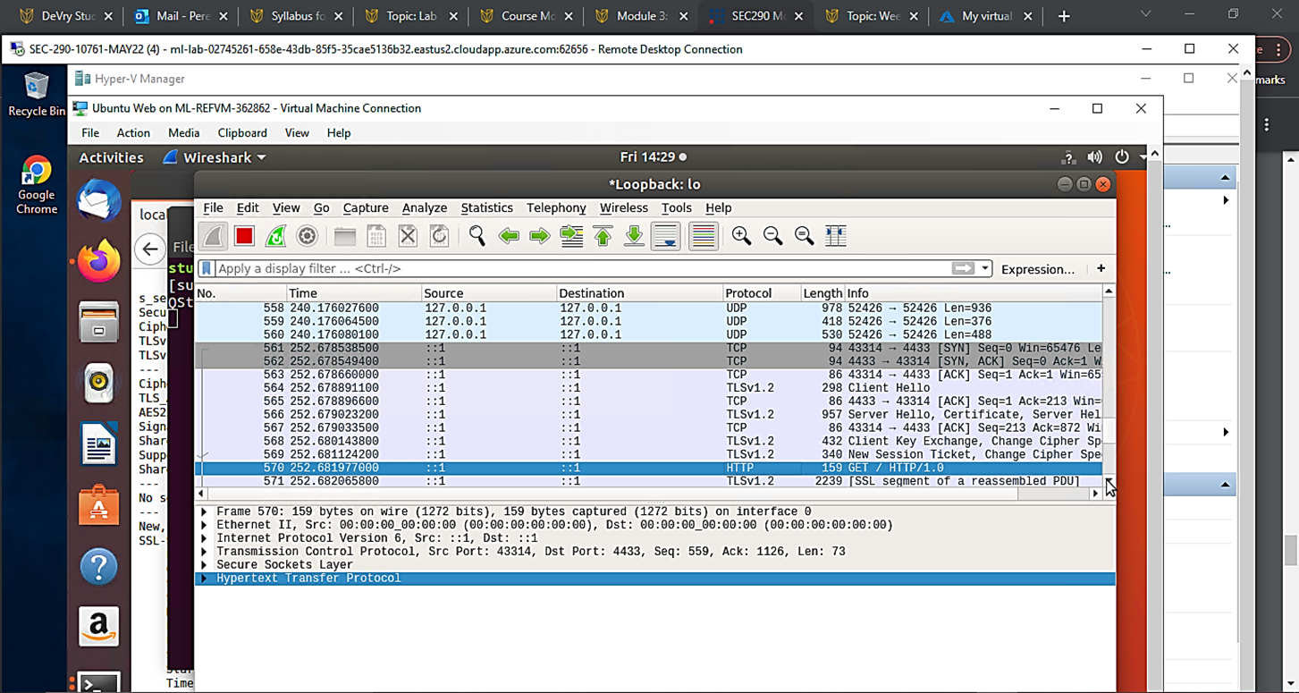
Creating and testing an SSL/TLS file (Part 1)
A screenshot of the output.
It shows the GET request in the Info column.

Slide 11
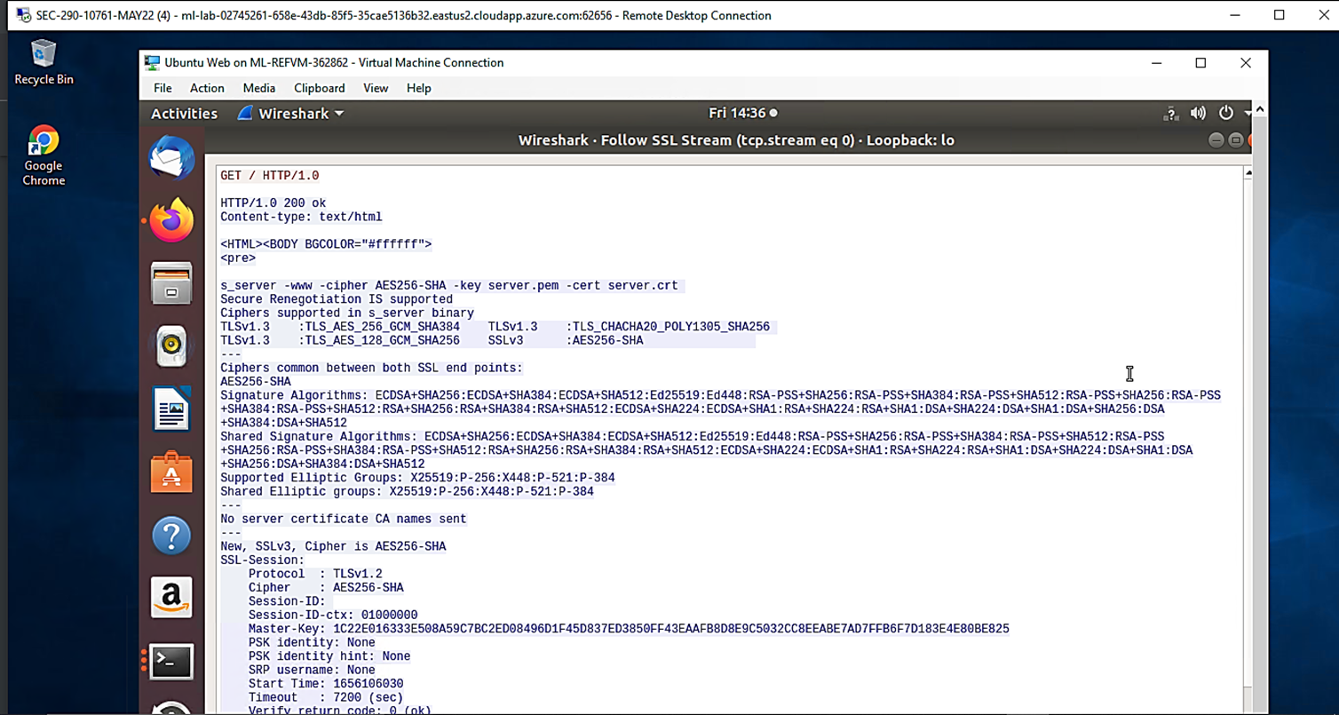
Creating and testing an SSL/TLS file (Part 2)
A screenshot of the output.
It shows the decrypted SSL stream.

Slide 12
What skills were learned?
Generating the public and private keys that will be used to encrypt all protected communication.

Slide 13
Module 4: Snort
In this module, we evaluated and developed rules by exploring Snort, an open-source Network Intrusion Detection System (NIDS).

Slide 14
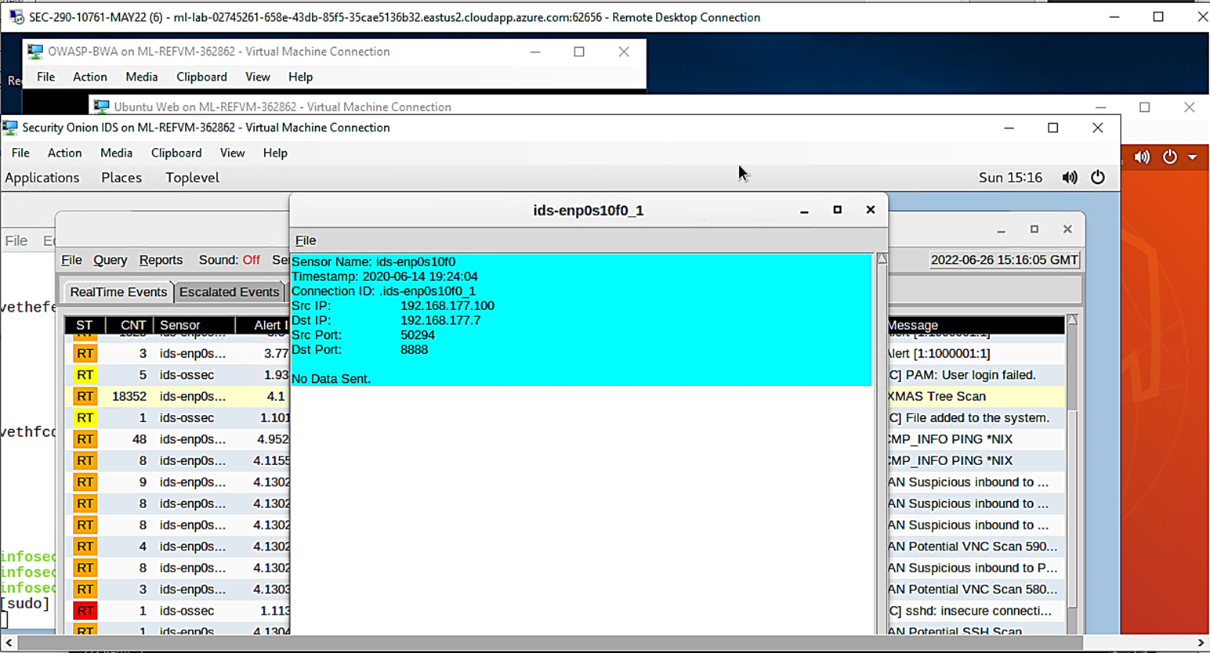
Testing Snort rules (Part 1)
A screenshot of the output. It shows the transcript of the XMAS scan alert.

Slide 15
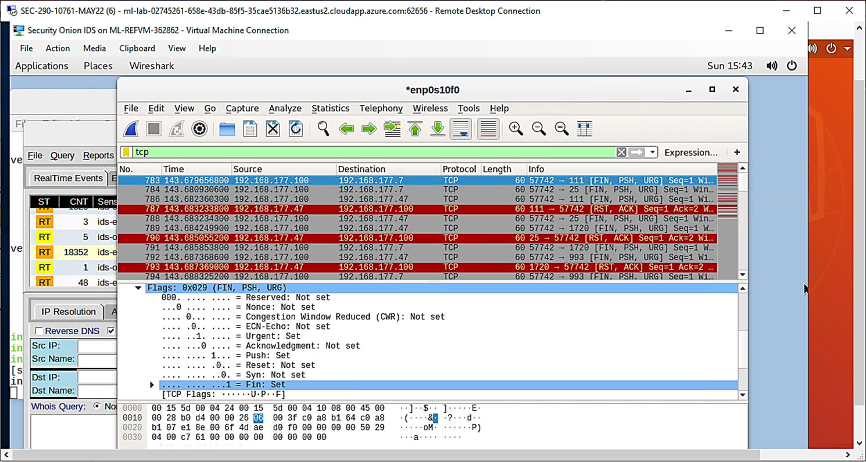
Testing Snort rules (Part 2)
Screenshot of the output.
It shows the TCP packets generated by the XMAS scan.

Slide 16
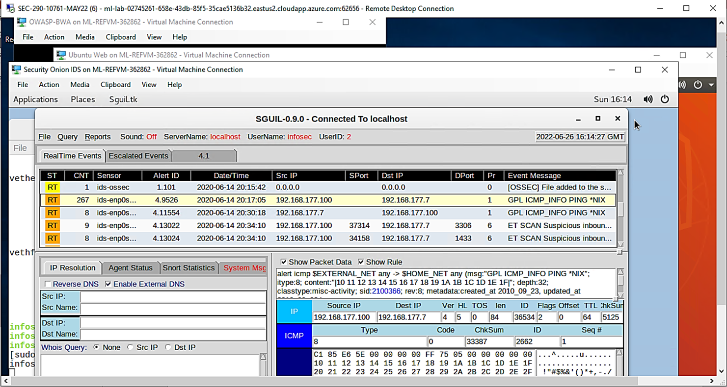
Creating Snort rules (Part 1)
This screenshot shows the ping activity alert.

Slide 17
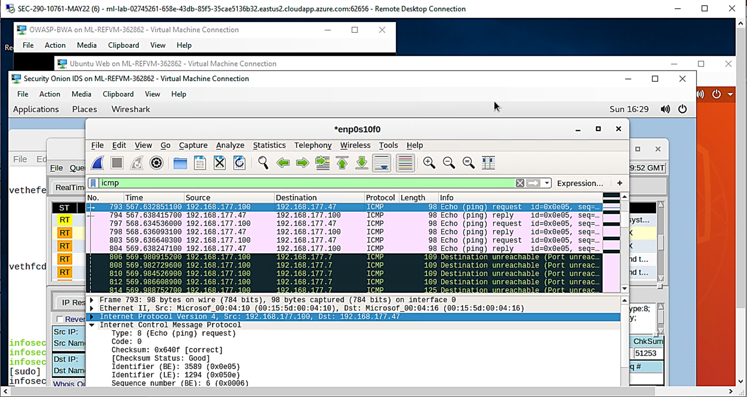
Creating Snort rules (Part 2)
This screenshot shows the ICMP packets generated by the ping activity.

Slide 18
What skills were learned?
Utilizing Security Onion IDS from the Linux machine, a network intrusion detection system (NIDS) called Snort. Numerous security tools, including Snort, Suricata, and Sguil, are included with the Linux distribution. Sguil offers a front-end web form for real-time IDS alert analysis.
New rule creation for Snort testing. The local.rules file contains the rule, which is then loaded again onto the Snort sensor.

Slide 19
Module 5: Live Memory Analysis
In this module, we have become acquainted with Linux and Microsoft tools that let us perform live memory analysis, covering topics such as:
Linux Processes
Process Hacker
Process Monitor
Volatility

Slide 20
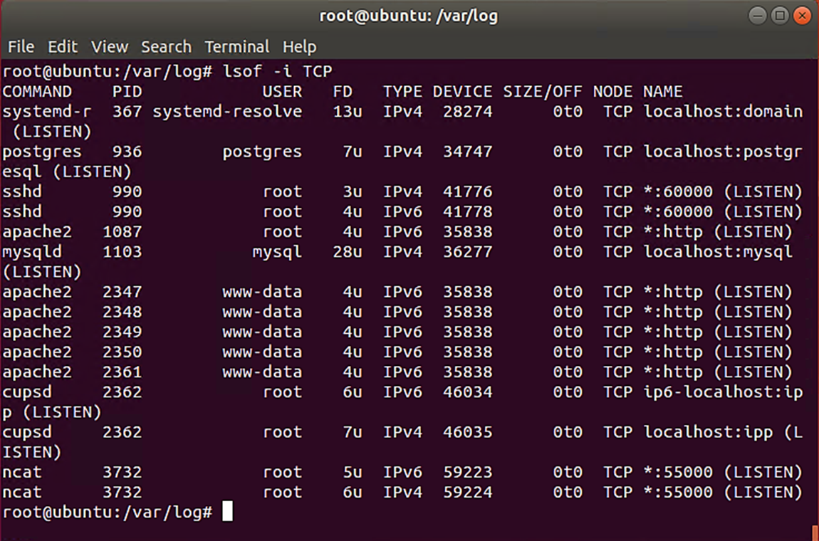
Linux Processes
This screenshot shows port 55000 open for both IPv4 and IPv6.

Slide 21
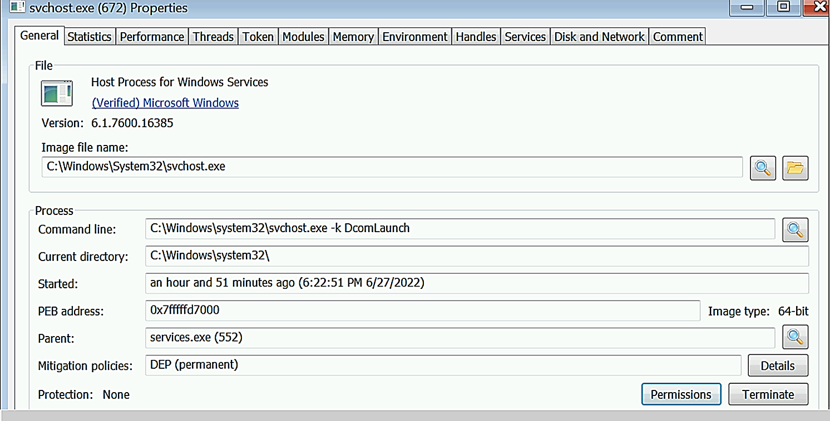
Process Hacker
This screenshot shows properties of a chosen process.

Slide 22
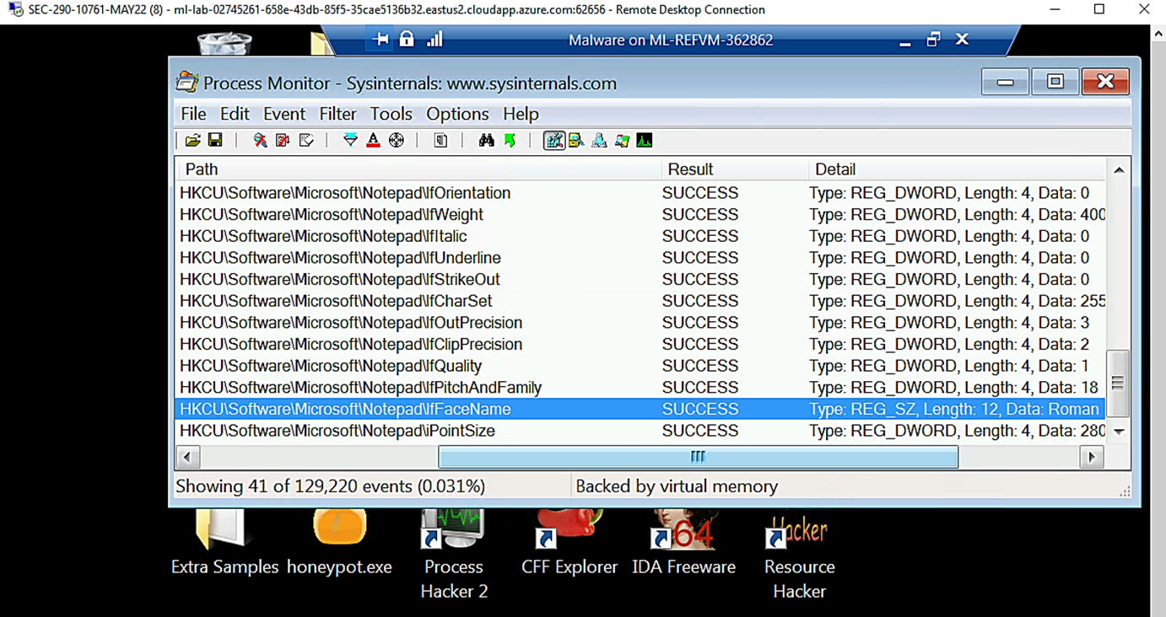
Process Monitor
This screenshot shows “ifFaceName” in the Path column and Data: Roman in the Detail column.

Slide 23
What skills were learned?
Exploring the process of memory analysis. Memory analysis is a key tool for cyber investigations as it enables an investigator to spot suspicious and questionable activities on a target computer or server. This is typically accomplished by running specialized software that creates a memory dump file, a snapshot of the system's memory as it exists. The investigator can then take this file offsite and search it.

Slide 24
Module 6: Firewall
In this module, we must set up iptables for network defense in the following six scenarios:
Time-based access
Blackhole routing
Bogon filtering
Stateful firewall
Dynamic NAT
Brute forcing of SSH logins

Slide 25
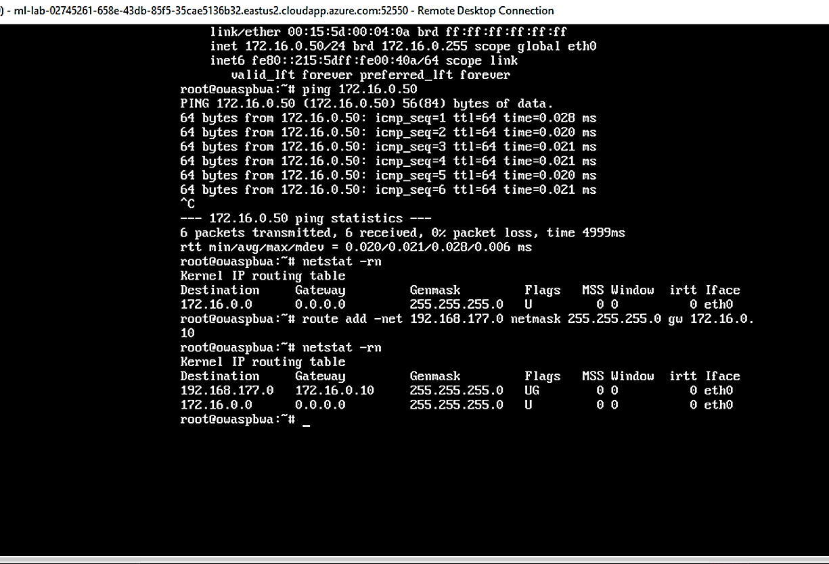
Time-based Access (Part 1)
This screenshot shows the output of the DMZ Route Table.

Slide 26
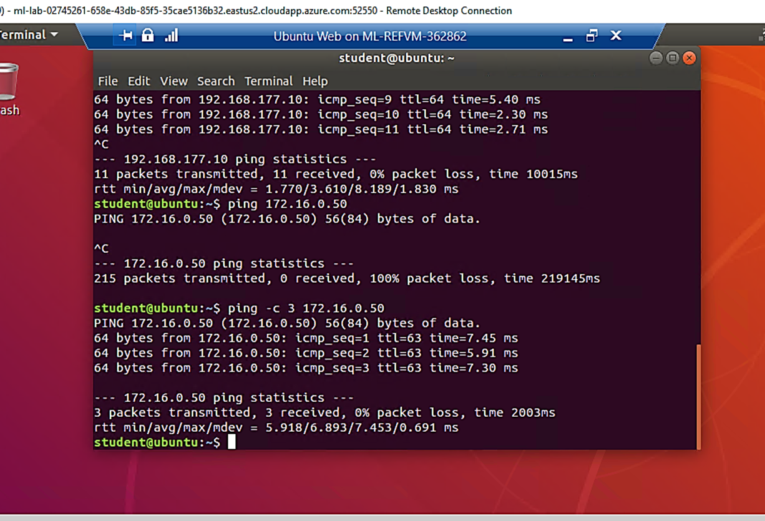
Time-based Access (Part 2)
This screenshot shows a successful ping from the Ubuntu Web VM and the DMZ VM.

Slide 27
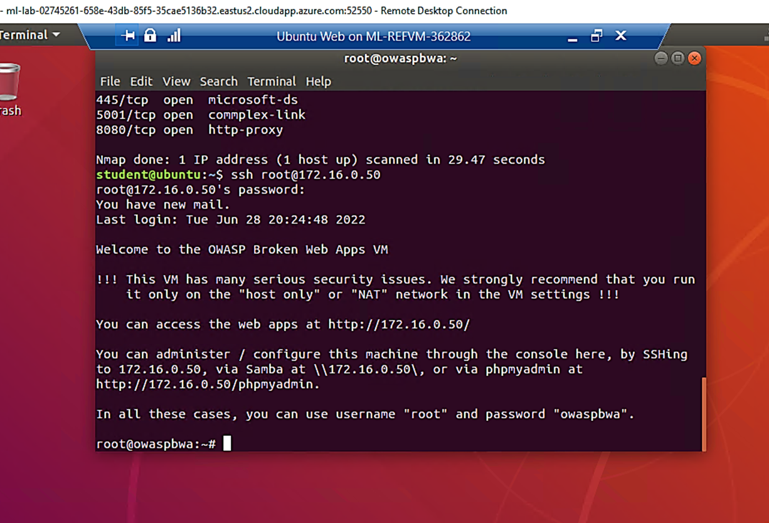
Time-based Access (Part 3)
This screenshot shows two time-based access rules in the FORWARD chain.

Slide 28
What skills were learned?
To set up the access controls for the demilitarized zone’s (DMZ) virtual machine. The configuration of the three machines is depicted in the graphic below. A Linux system serving as a firewall makes up the firewall machine. It has three interfaces, the third of which is for the internal network and is not relevant to our needs (the diagram does not display it).
A network path that leads nowhere is known as a black hole route. When packets are received that match the criteria, they are automatically dropped. In short, we direct the attacker in a particular direction.

Slide 29

What was learned in the course?
Infrastructure security, including vital infrastructure security, is crucial for avoiding attack or disaster-related damage to technology assets and data. Additionally, it's essential for minimizing the amount of damage in the event of a successful attack or a disaster. Similar to this, infrastructure security's main objective is to reduce the overall risk level that the organization faces, which reduces the likelihood of a serious operational disruption and/or financial impact on numerous companies.

Slide 30

Thank You!
Feedback is welcome!

