Slide 1
Introduction to Programming Portfolio
Blanche Perez
DeVry University
CEIS110

Slide 2
This Portfolio Contains:
Introduction
Modules
What was learned in each module
Conclusion

Slide 3
Introduction: What is computer programming?
Professionals use computer programming to write code that instructs how a computer, application, or software program works. Computer programming is, at the most simplistic - series of instructions to facilitate specific actions.

Slide 4
Module 2: Design and Library Setup
For this module, a flowchart had to be completed for installing Python, downloading and analyzing weather data.

Slide 5

Flowchart
Includes the following processes:
Install Python
Download weather data to a database
Extract weather data from database into a comma separated file with Python
Cleanse weather data
Use Excel to manipulate data
Use python data analytics modules to develop graphical models

Slide 6
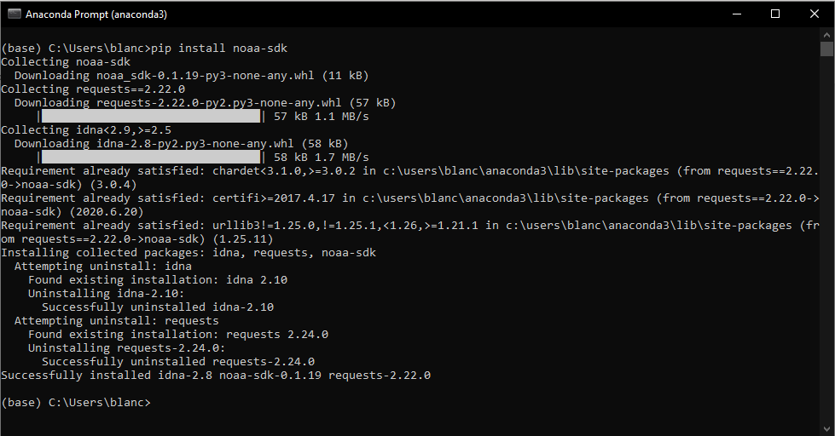
Software Inventory
Screenshot
Screen capture of NOAA-SDK library installed. It displays the result, "Successfully installed noaa-sdk" of pip install command is visible.

Slide 7
What was learned in this module…
Using critical thinking skills to figure out and translate a new computer language.
Research and learn more about the computer software language program that you have downloaded.

Slide 8
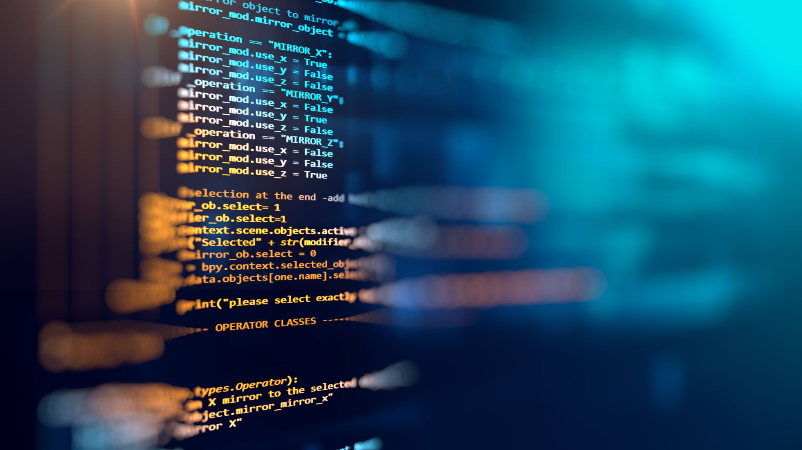
Module 3: Downloading Weather Data
In this module, we had to import a data set of recent weather observations for the area we reside, create a Python program and run it. On the computer's hard drive, the Python software can create a database and archive the weather data in a table for future study.

Slide 9
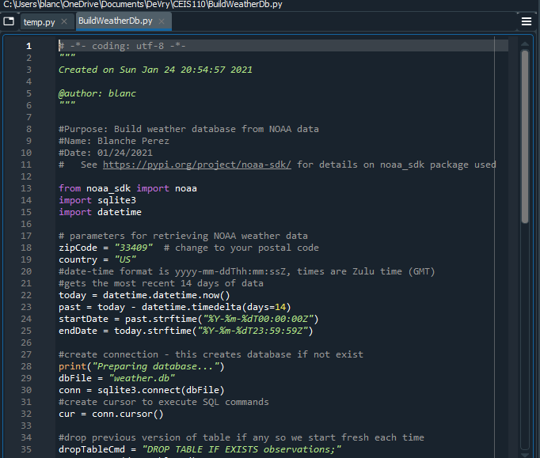
BuildWeatherDb.py Code Screenshot
Screen capture of code in Spyder.
Must have name and date in comments.
Must have zip code.

Slide 10
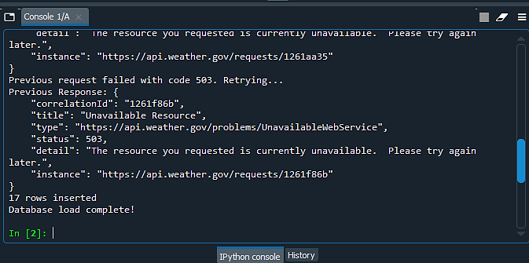
Python Console
Screenshot of program output in Python console showing program executed successfully.

Slide 11

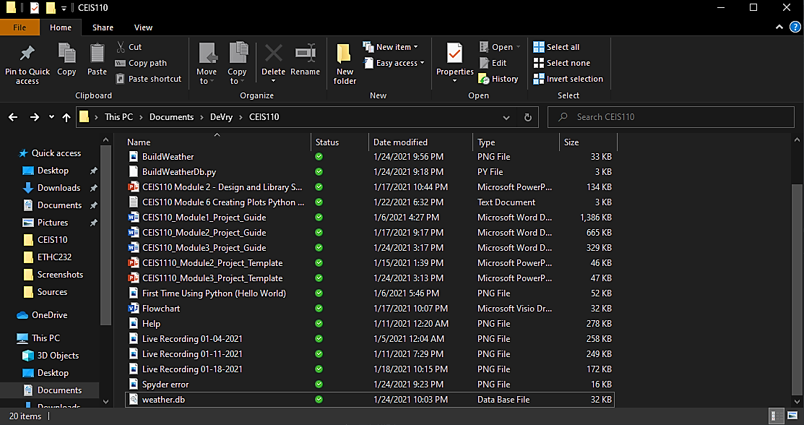
Weather.db File
Screenshot of Windows Explorer showing database file Weather.db was created.

Slide 12
What was learned in this module…
Typing in the correct command prompts to have the precise output.
Learning to download and extract software data through Python.

Slide 13

Module 4: Querying the Database With SQL
For the SQLite database we have used in this project, SQLiteStudio, which we had to install, is such a great tool. We have used SQLiteStudio at this point of the project to issue a SQL query command to the database and display the results. In the next step, we had to extract data from the database and save it to an Excel file using a similar SQL query embedded in a Python program.

Slide 14
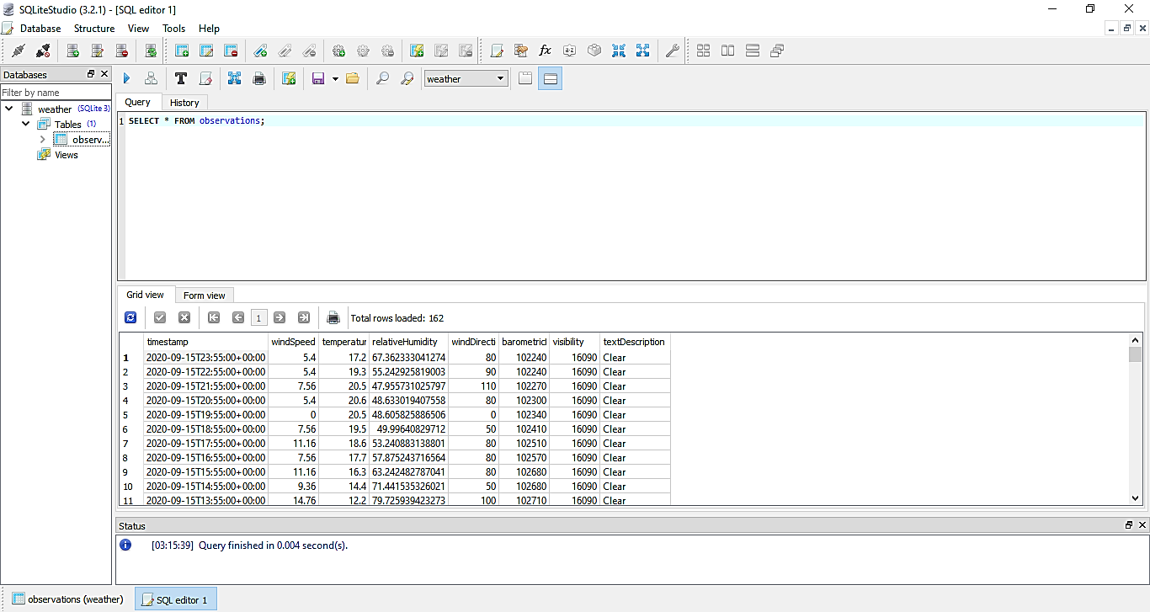
Query to retrieve all columns and all rows (Screenshot)
Screen capture of SQL query command and results.

Slide 15
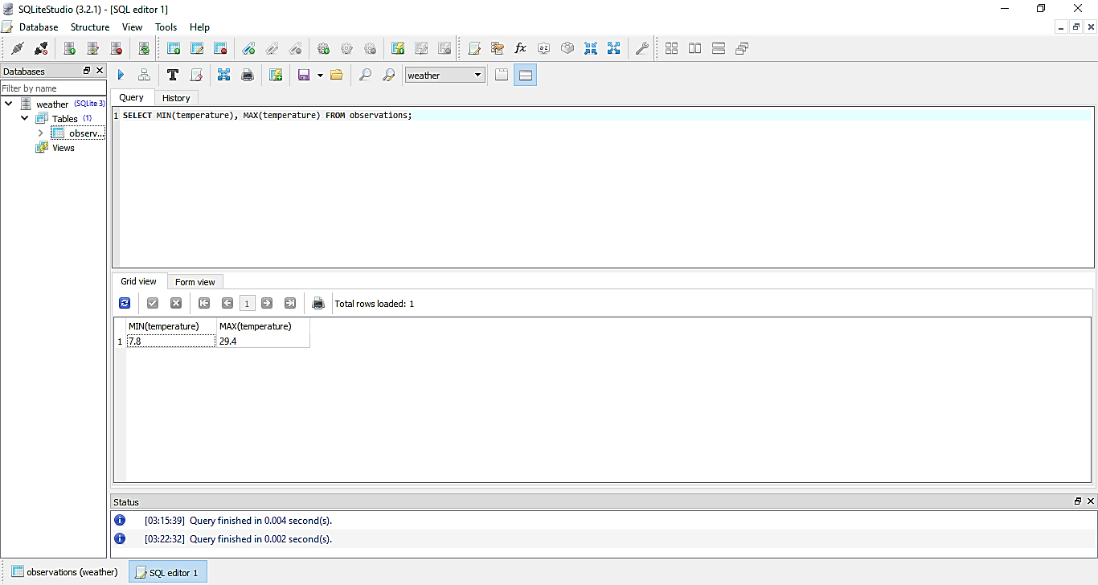
Query to retrieve lowest and highest temperatures
Screenshot of SQL query command and results.

Slide 16
What was learned in this module…
A specialized programming language for operating with a relational database is the Structured Query Language (SQL).
Client tools are used with database systems to allow users to issue SQL commands to a database and display the results.

Slide 17
Module 5: Querying and Manipulating Data With SQL and Python
In this module, Python will read the data contained in a database table into a list and process it. The database's records must be cleansed, and all spurious or missing information deleted. Companies often use data cleaning to ensure that their data is complete, accurate, and standardized.

Slide 18
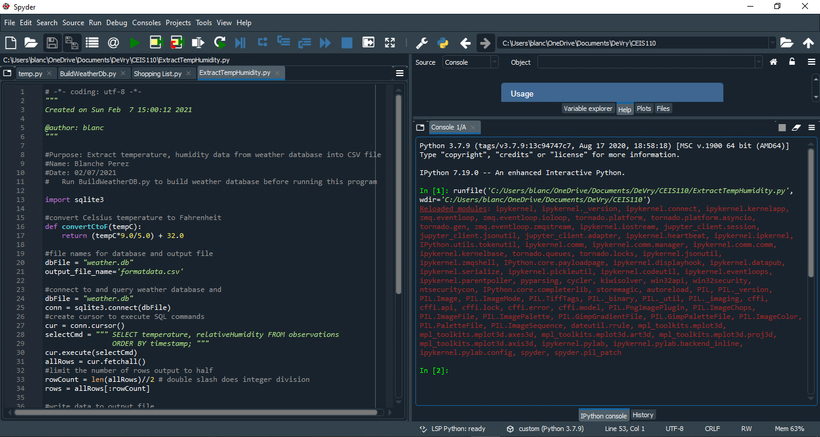
Python code (Screenshot or file)
ExtractTempHumidity.py Python code with name and date in comments.

Slide 19
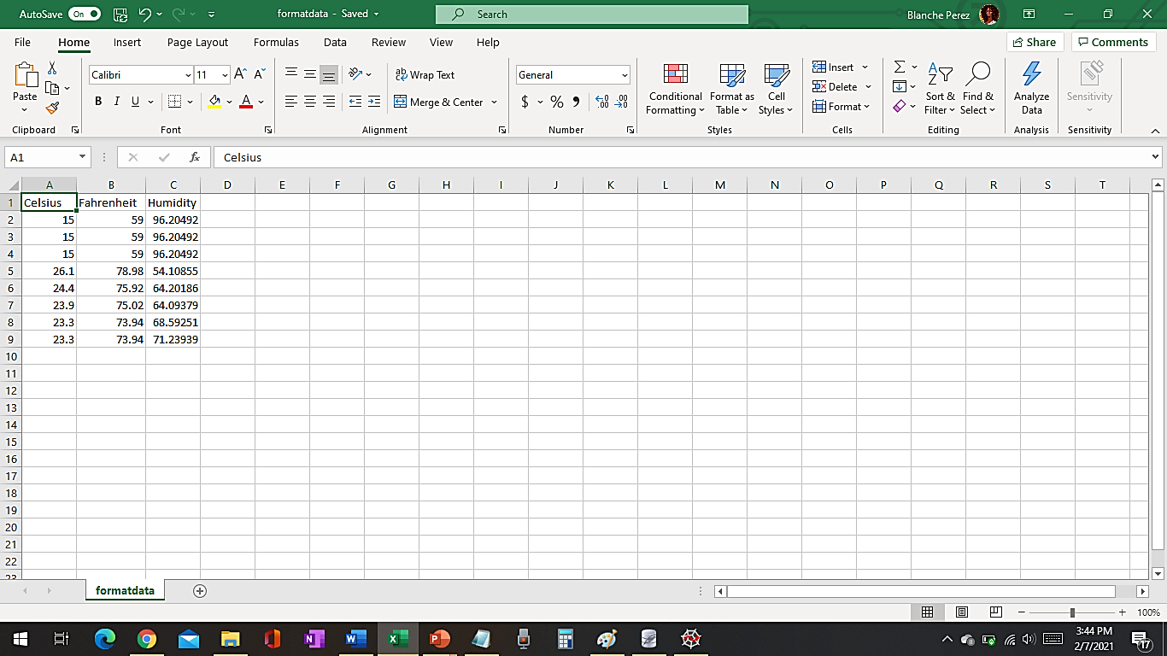
Retrieve and Convert Data to CSV Format (Screenshot)
“Formatdata” file open in Excel showing 3 columns of data.

Slide 20
Temperature and Humidity Chart
(Graph)
Excel chart based on temperature and humidity data from database.

Slide 21
What was learned in this module…
Transforming weather data and making sure to put your name, date and zip code when using Python.
Using Excel to graph the extracted weather data into a simple graph.

Slide 22
Module 6: Develop Graphical Models and Interpret Results
A considerable amount of data is created by IoT devices, websites, social media, and other outlets. It is necessary to collect, archive, clean, process, and analyze this data. The storage and analysis of the data has been the subject of every phase in this project. This portion of the project focuses on data processing using Python's pandas data analytics framework. The module for pandas is part of the Anaconda distribution of Python.

Slide 23
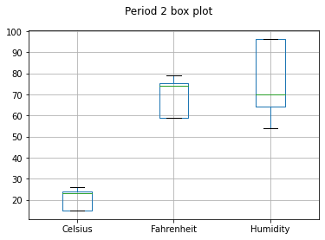
Plot #1
Different types of plot and code could be used, such as:
Box
Line
Histogram
Scatter
Research your own!

Slide 24
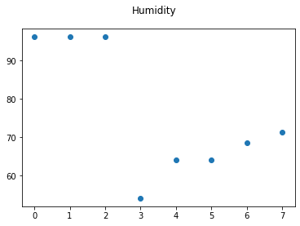
Plot #2
Plot used:
Scatter
Note: Had plenty of difficulty to extract new data and only past data from the day before came up.

Slide 25
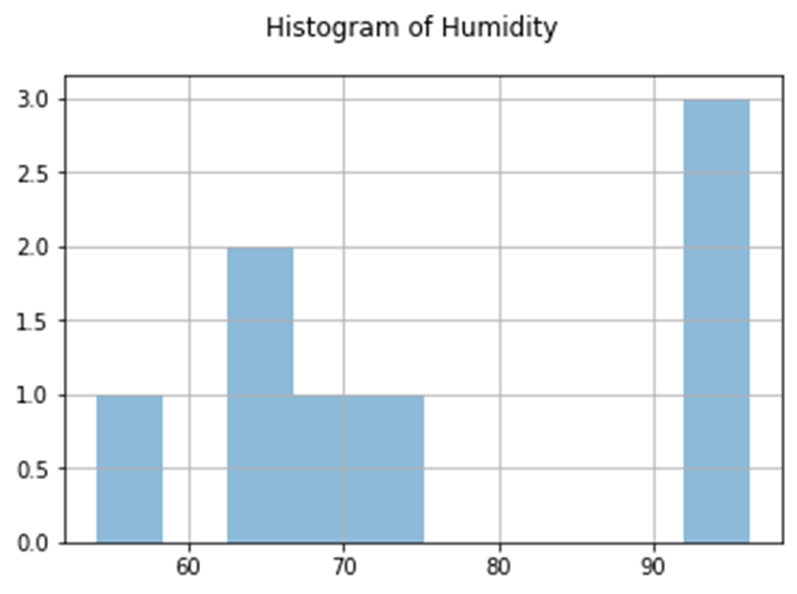
Analysis
My own question:
Why is there only one piece of data showing and the other is missing?
Answer supported by Chart:
Due to too many mistakes, the wrong information was entered into the code and only one piece of data is being displayed.

Slide 26
What was learned in this module…
Question: Develop a prediction based on the data. What variations in temperature and humidity do you expect over the next few hours or days? How would humidity change if temperature goes up or down?
Answer: With only little information available to me, I can only see that the next few days the temperature could increase, as well as the humidity. It possibly become more humid as it becomes warmer in the next few days.
Note: What was learned here, was to learn from previous material to extract new weather data in order to compare one day to another. (i.e., analyzing and graphing different weather data)

Slide 27

Conclusion…
Overall, the computer programming field may be a difficult area to look into. However, as soon as you can gain the knowledge just by learning and researching more information, and to firmly grasp the concept to apply it to what you have learned within the career of your choice.

Slide 28
Thank you!
Feedback is welcome.

